Slide 1

UPSC Prelims PYQ Analysis

Slide 2
This report analyses 13 years of UPSC Prelims PYQ trends (2013–2025).
It uses subject-wise yearly trends, recent yearly question compositions, dominant subtopic clusters (L2, L3, L4), and overall subject weightage.

Slide 3
1) Individual Subject wise Trends from 2013 to 2025

Slide 4
Overall Observation:
Polity: Consistently stable. Around 15–20 questions every year.
Environment: Averaging 12–17 questions per year, mild rise post-2014. More Volatile in trend.
Economy: Remains steady at 15–20 questions each year. Highest 30 in 2014 and 21 in 2025
Geography: Recent spike to 17-19 questions from 2022 to 2024. Slight dip to 15 in 2025.
Science & Tech: More volatile. Lowest 9 in 2024 and highest 16 in 2019.
Art & Culture: Modest 3–5 questions each year. No upward trend.
History: consistently 10–12 questions.visible dip from 2020 to 2024. Resurgence in 2025-14 Q
IR & Internal Security: linked to current events. 3-5 questions on average.

Slide 5
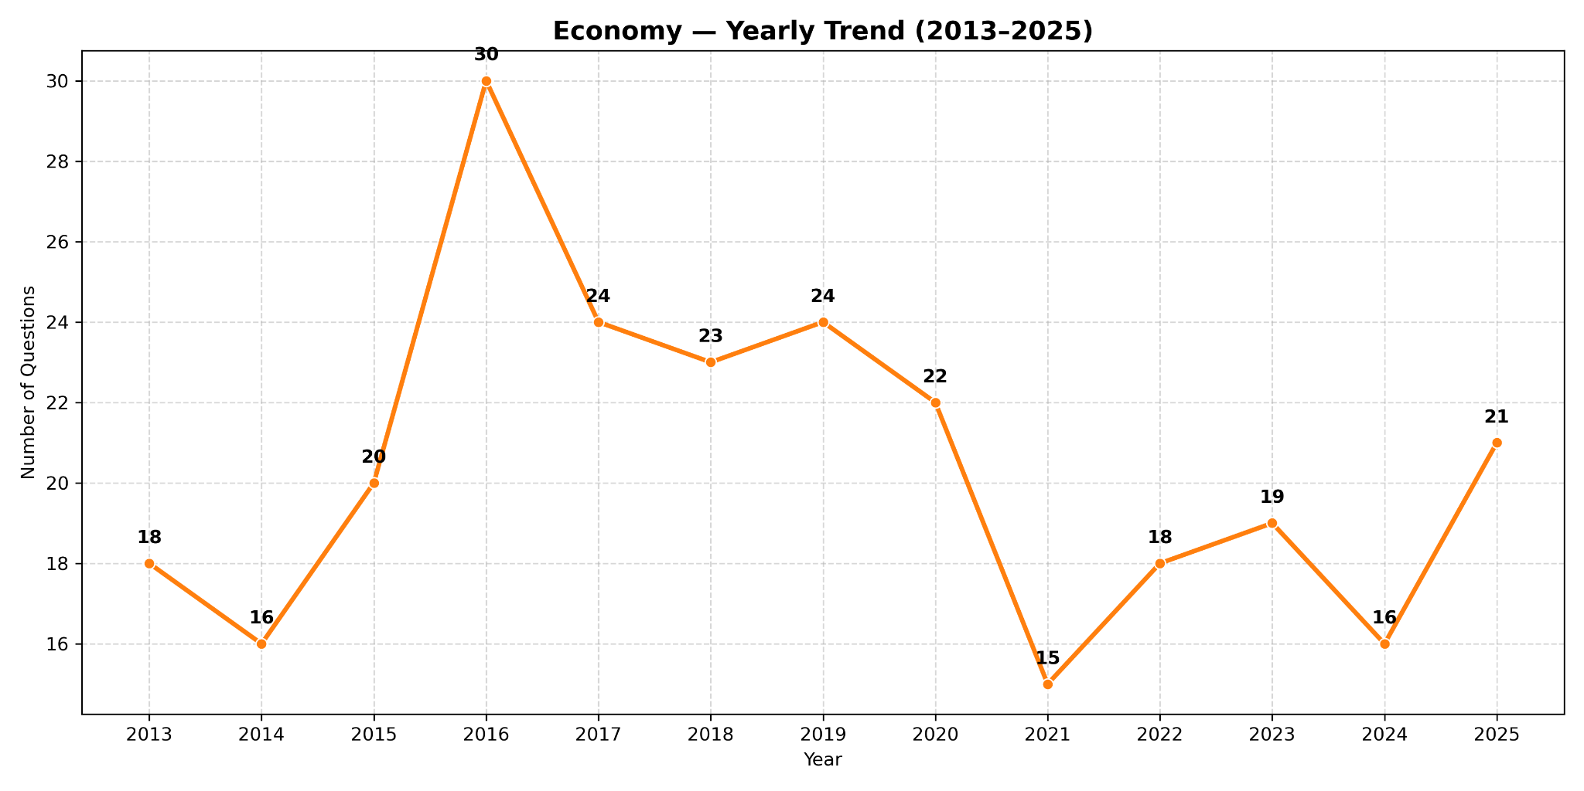

Slide 6
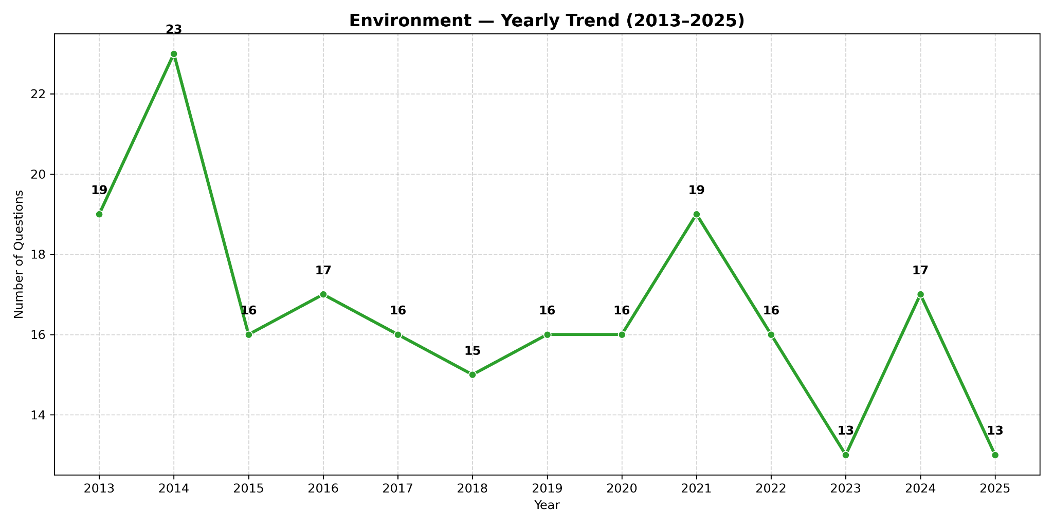

Slide 7
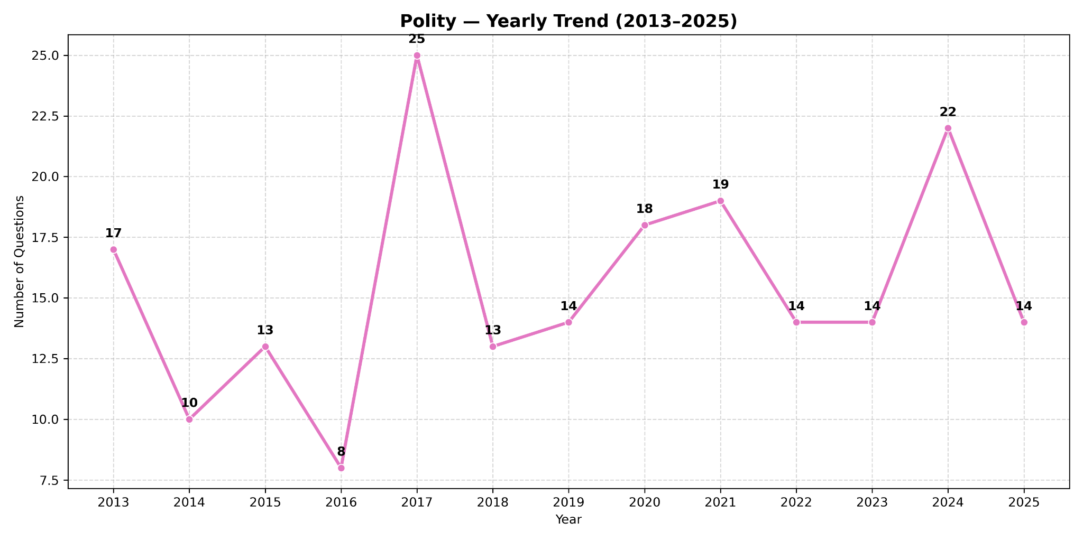

Slide 8
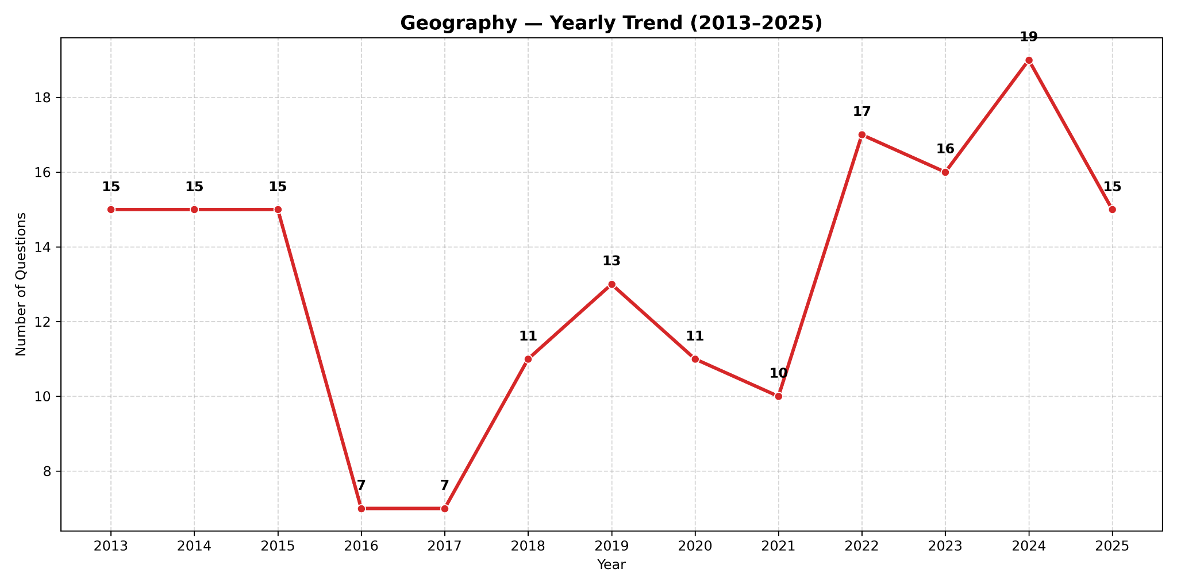
Notes:
In 2024 : 19 Questions

Slide 9
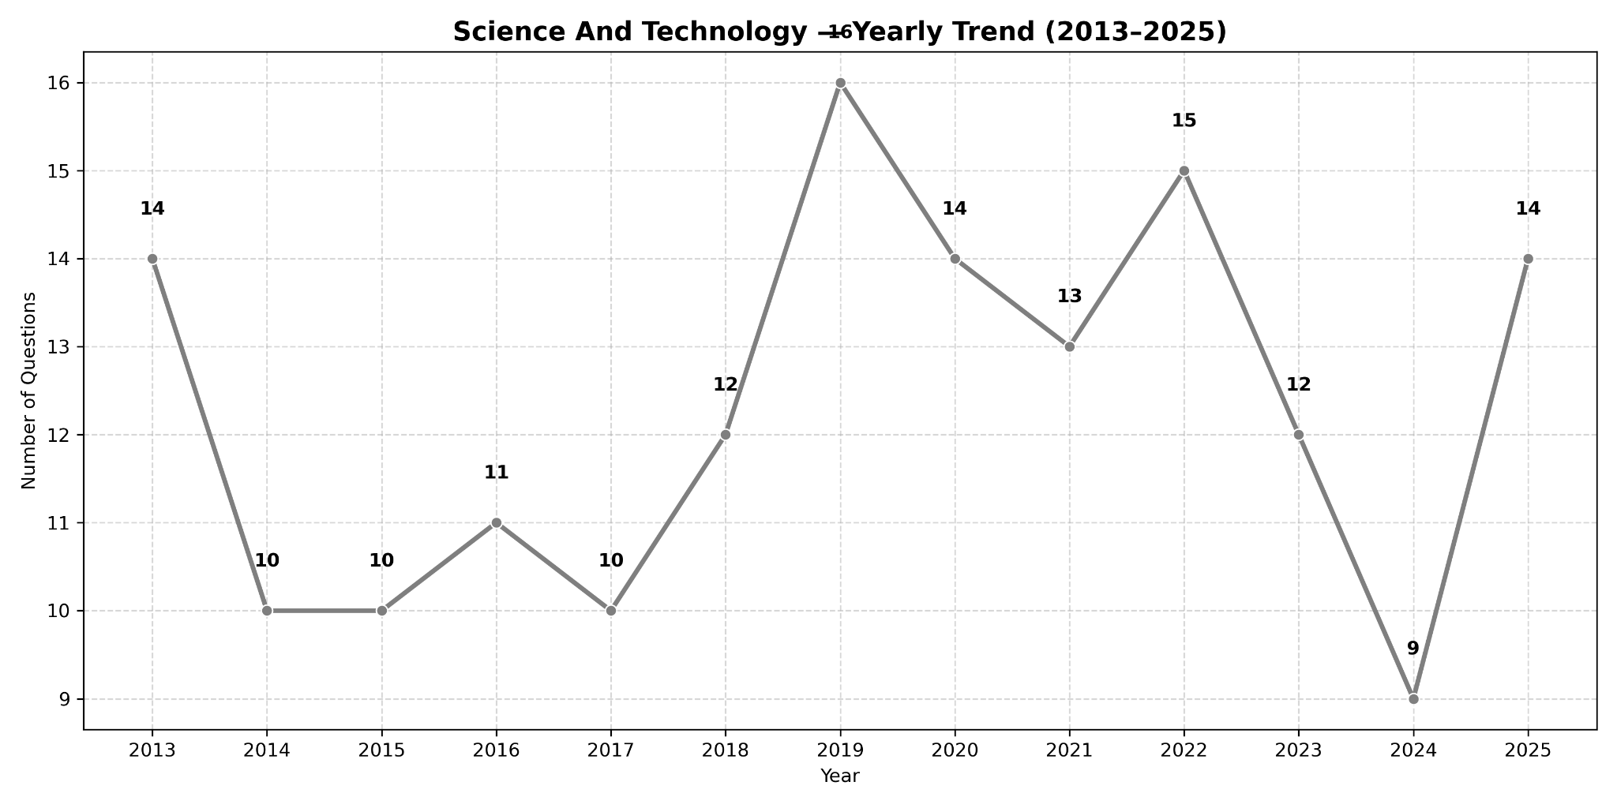
Notes:
In 2019 : 16 Questions

Slide 10
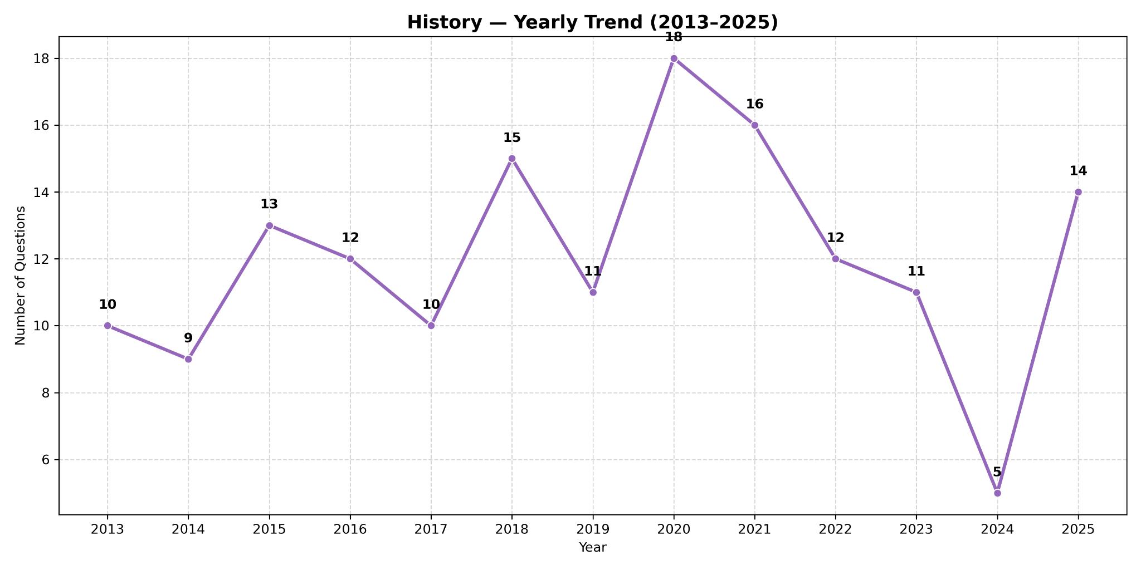
Notes:
In 2020 : 18 Questions

Slide 11
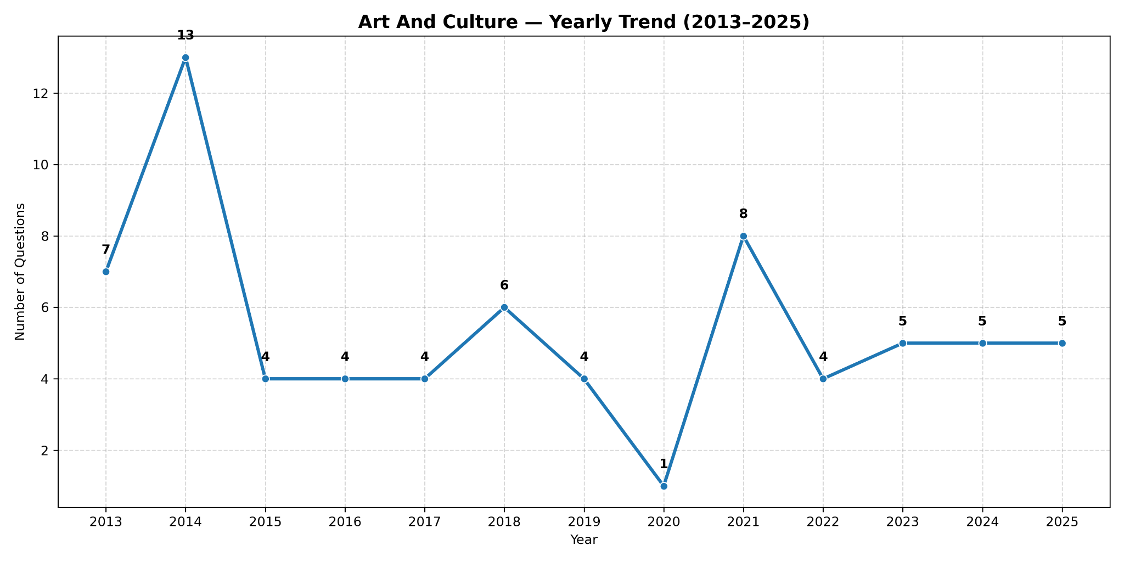
Notes:
In 2014 : 13 Questions

Slide 12
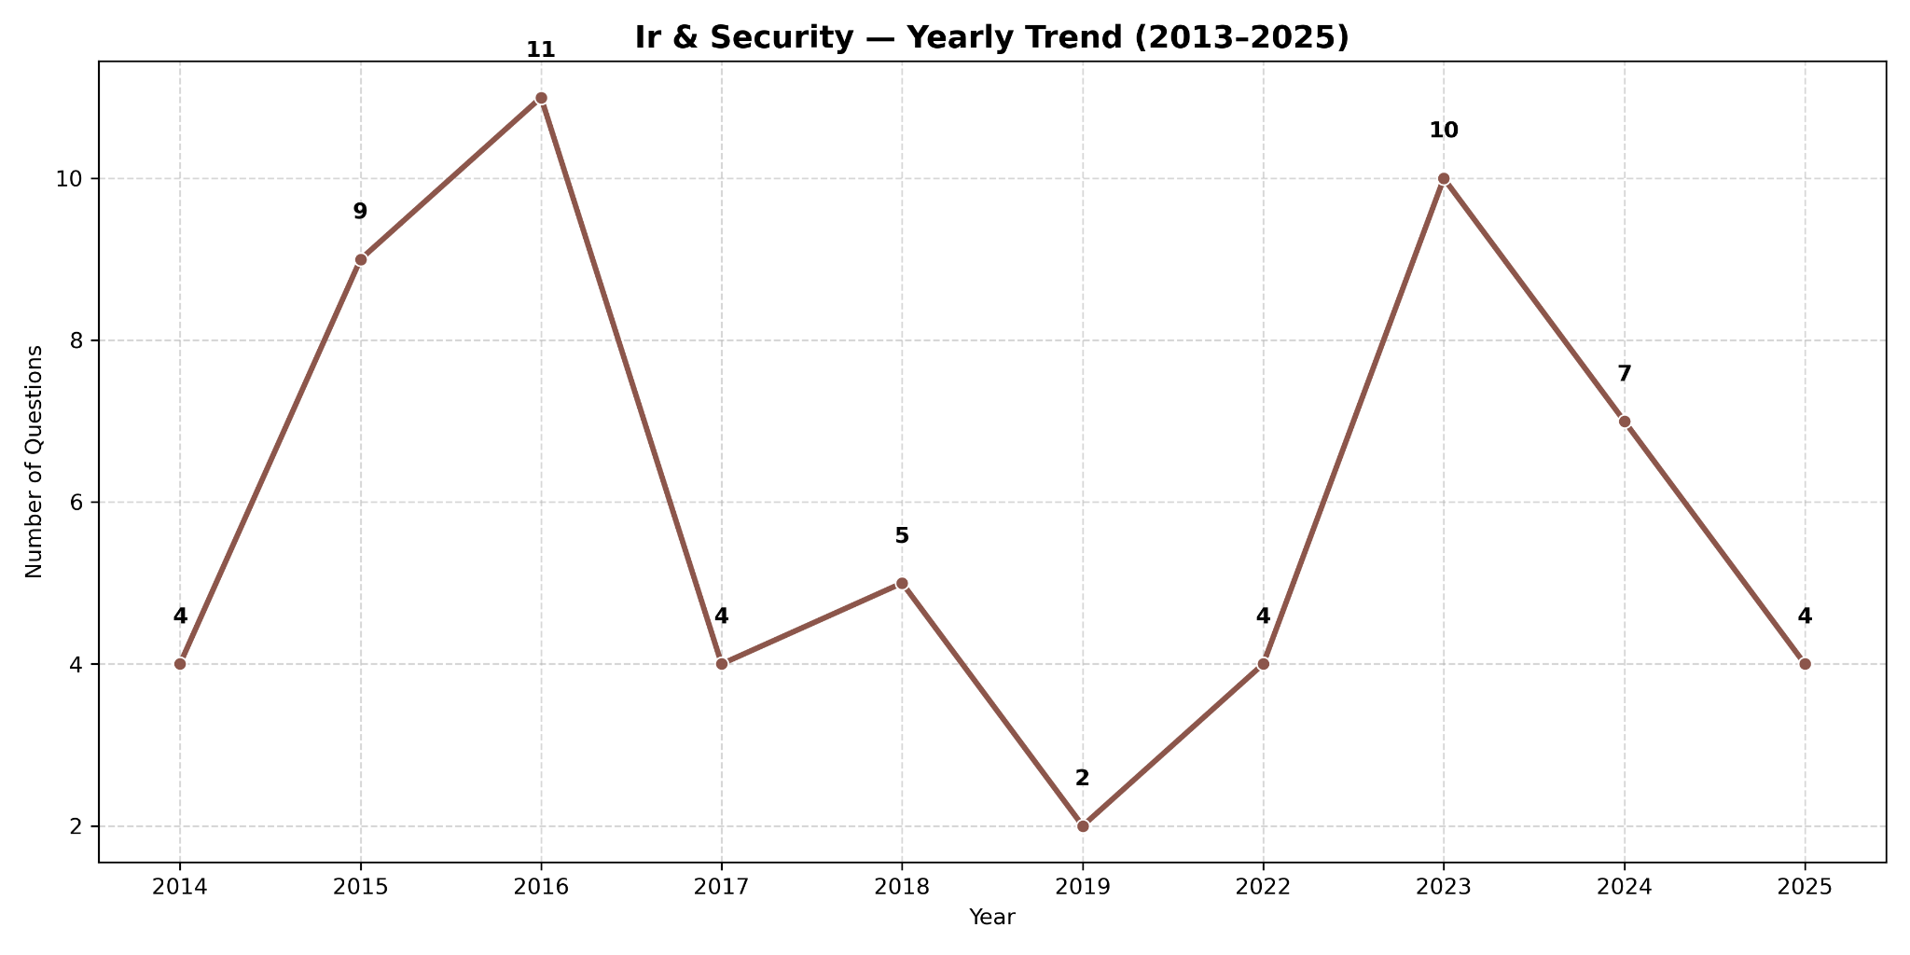
Notes:
NOTE: There Was NO questions asked in 2020,2021 from this Subject

Slide 13
2) Yearly Subject Distributions (2021-2025)

Slide 14
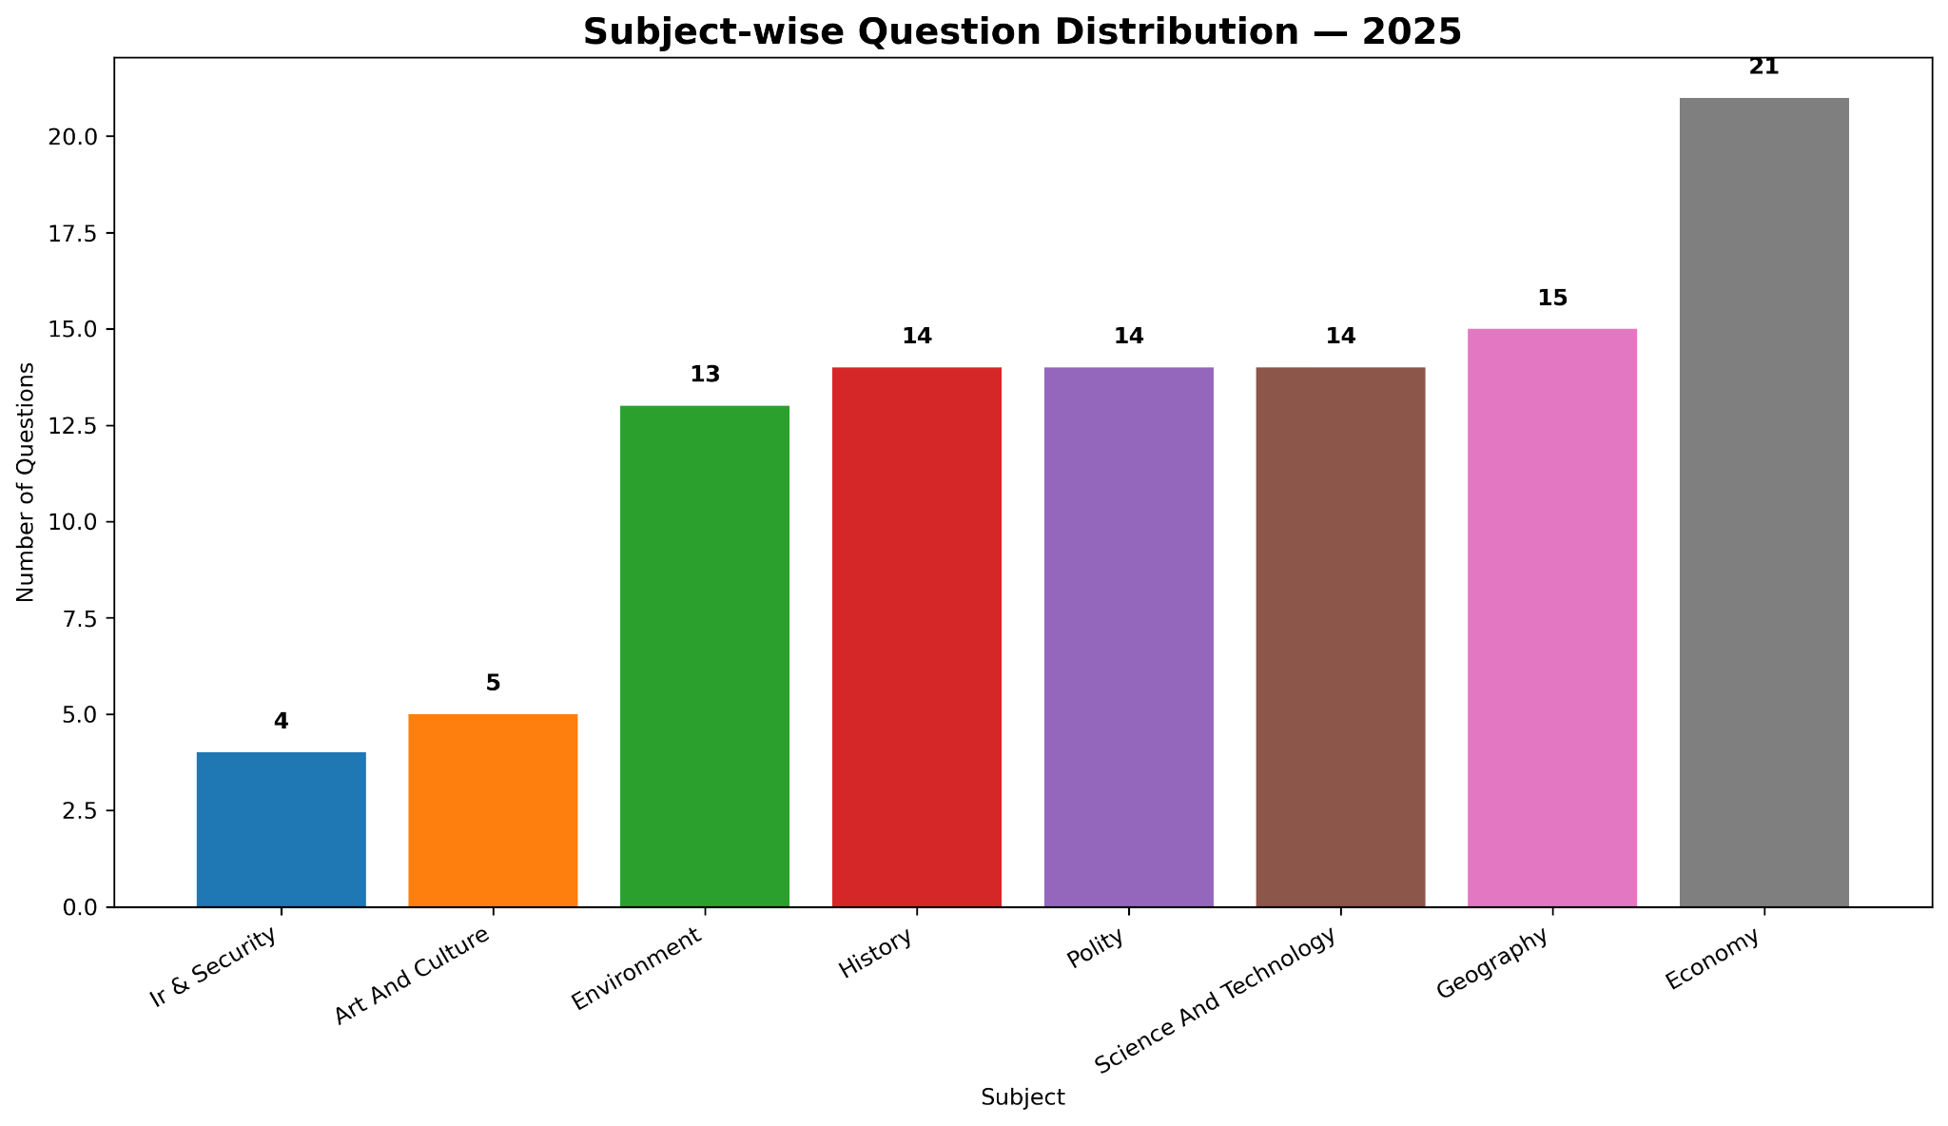

Slide 15
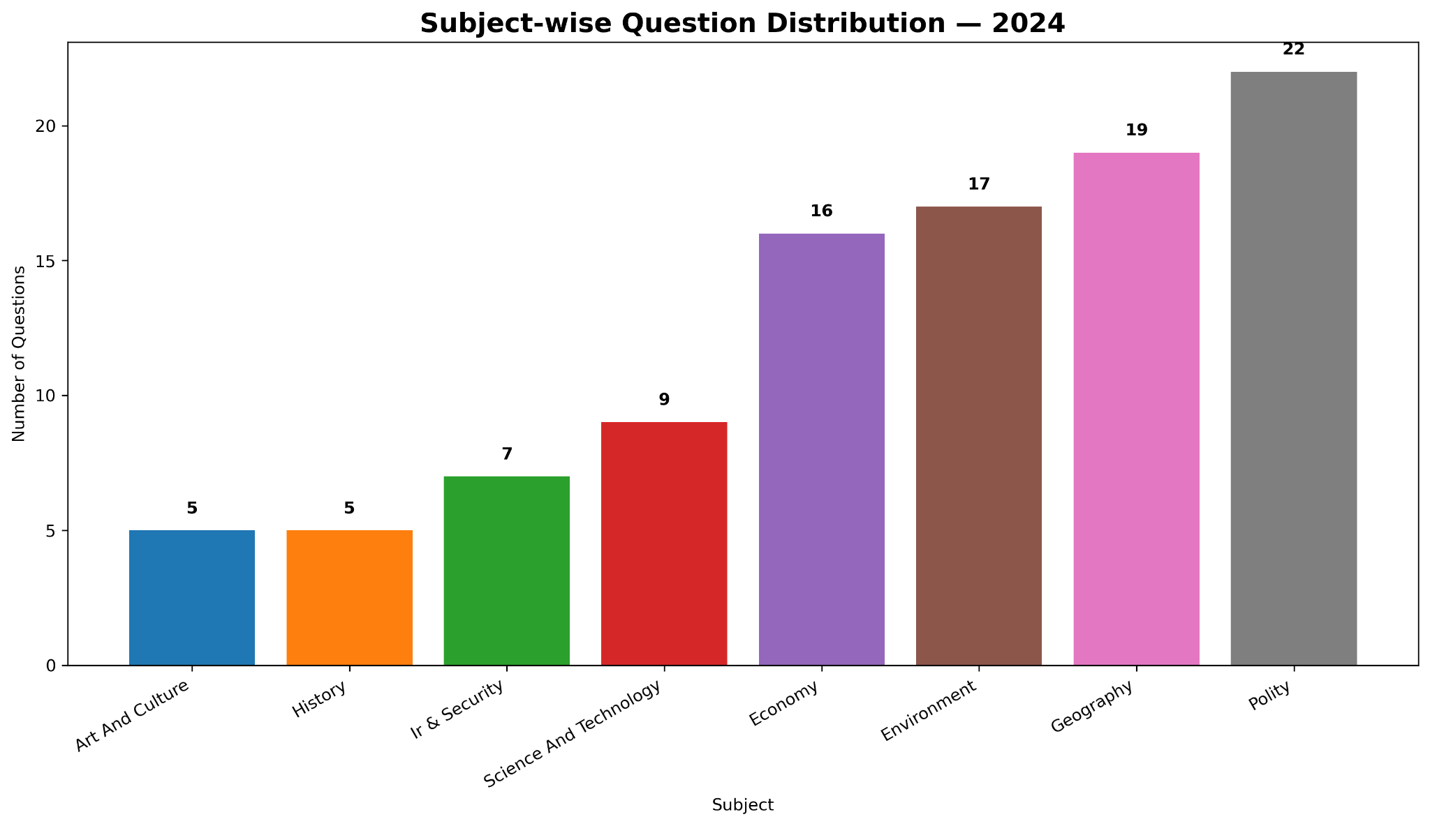

Slide 16
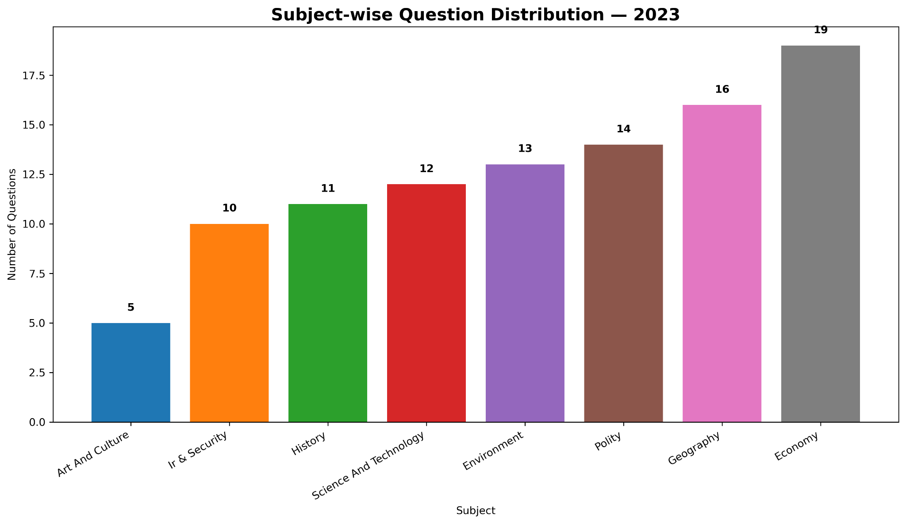

Slide 17
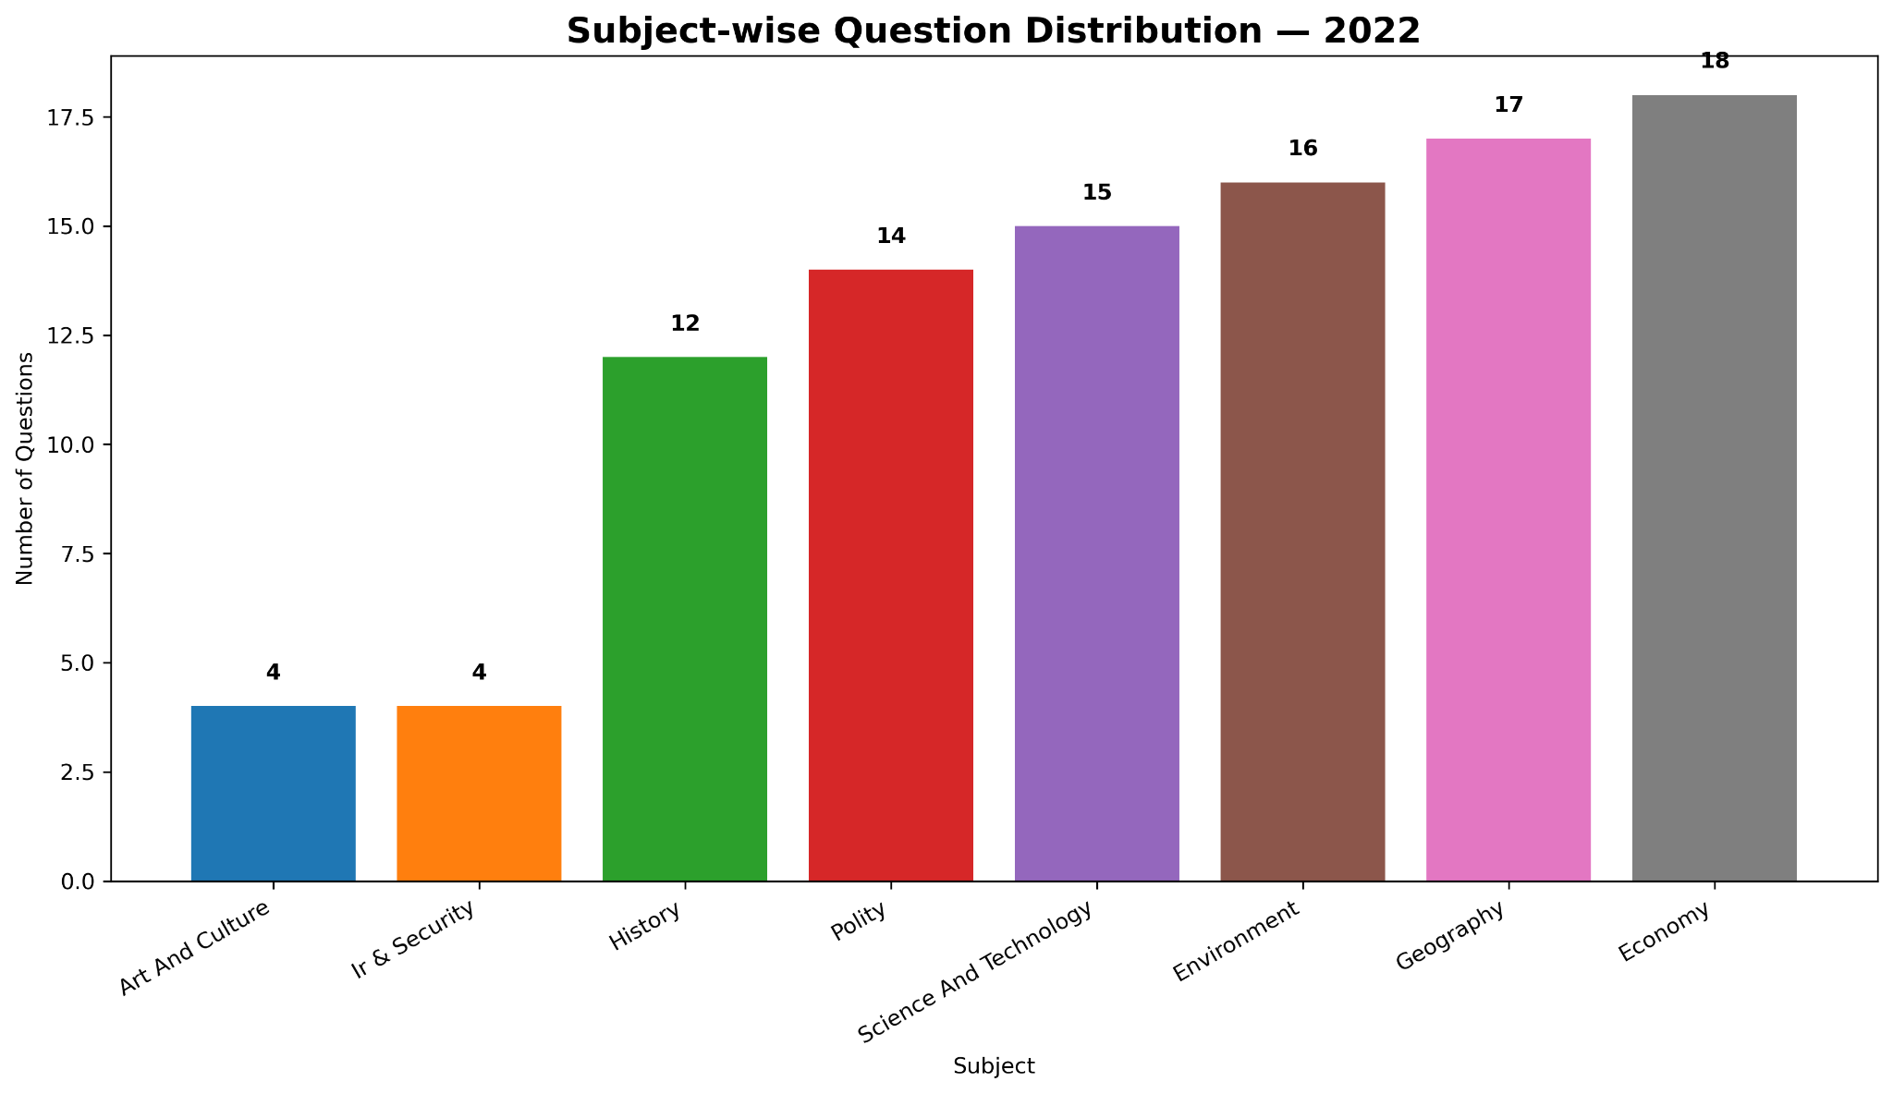

Slide 18
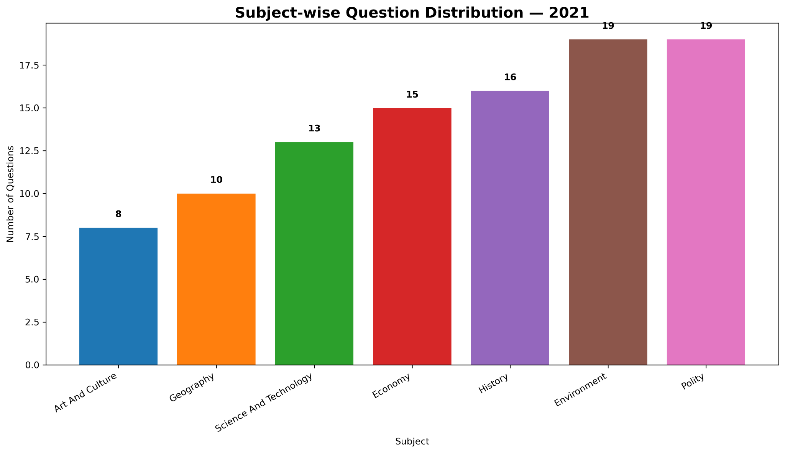

Slide 19
3) Top Subtopics: L2, L3, L4 - Subject Wise (2013–2025)

Slide 20
ECONOMY

Slide 21
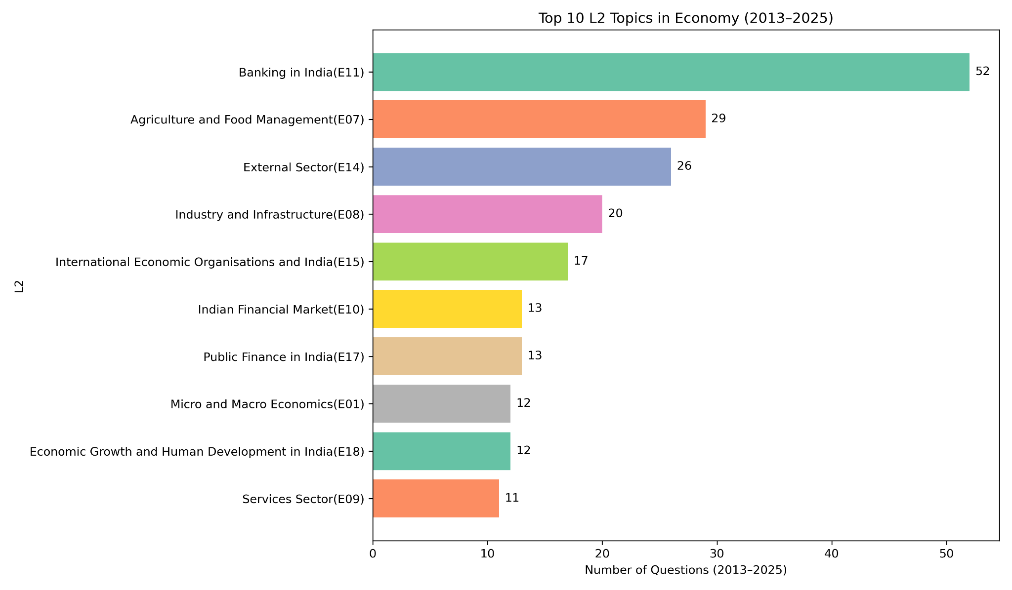

Slide 22
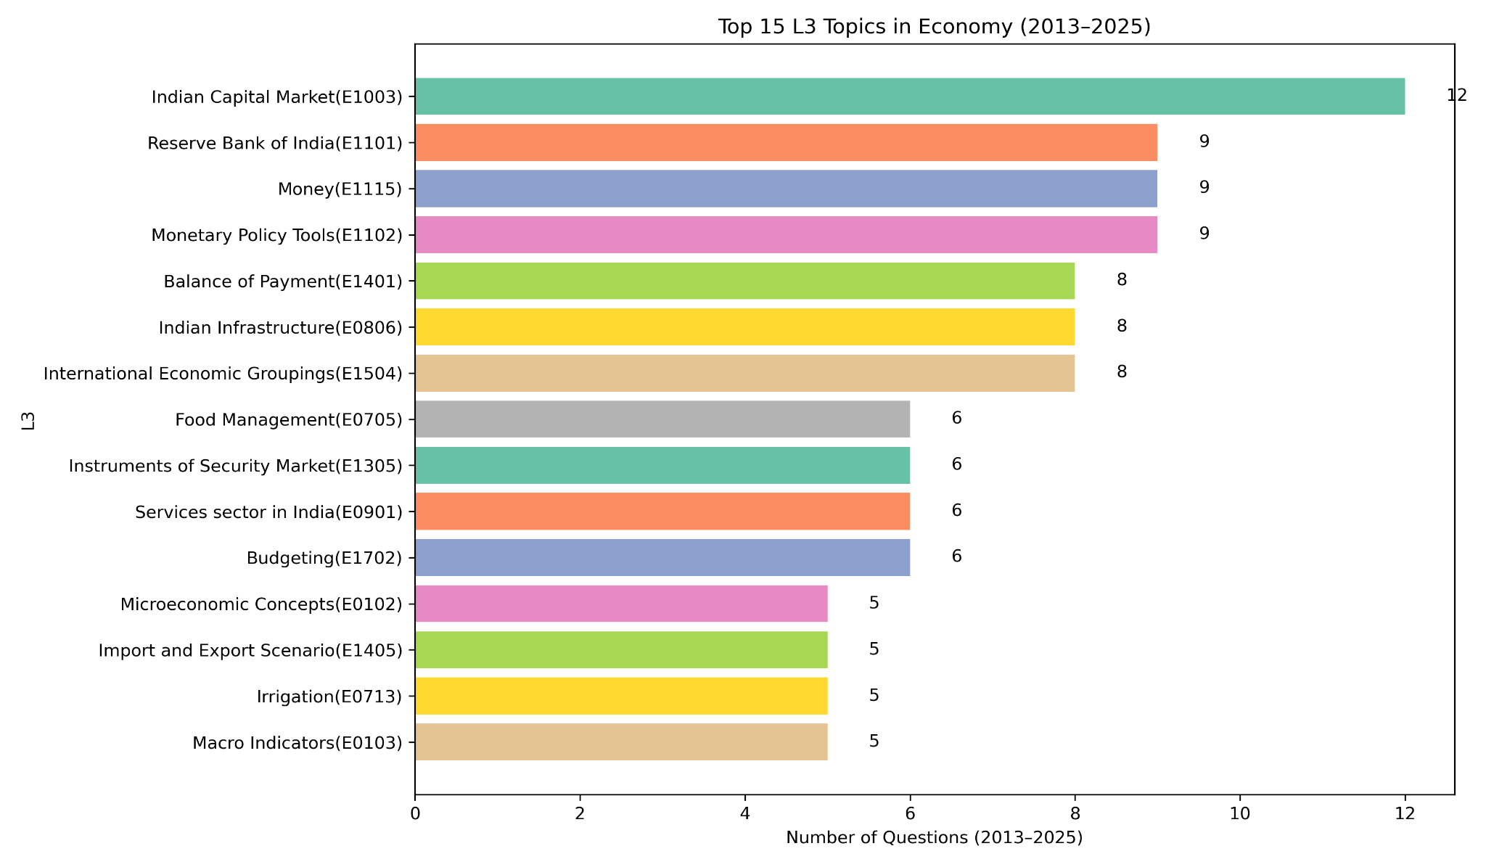

Slide 23
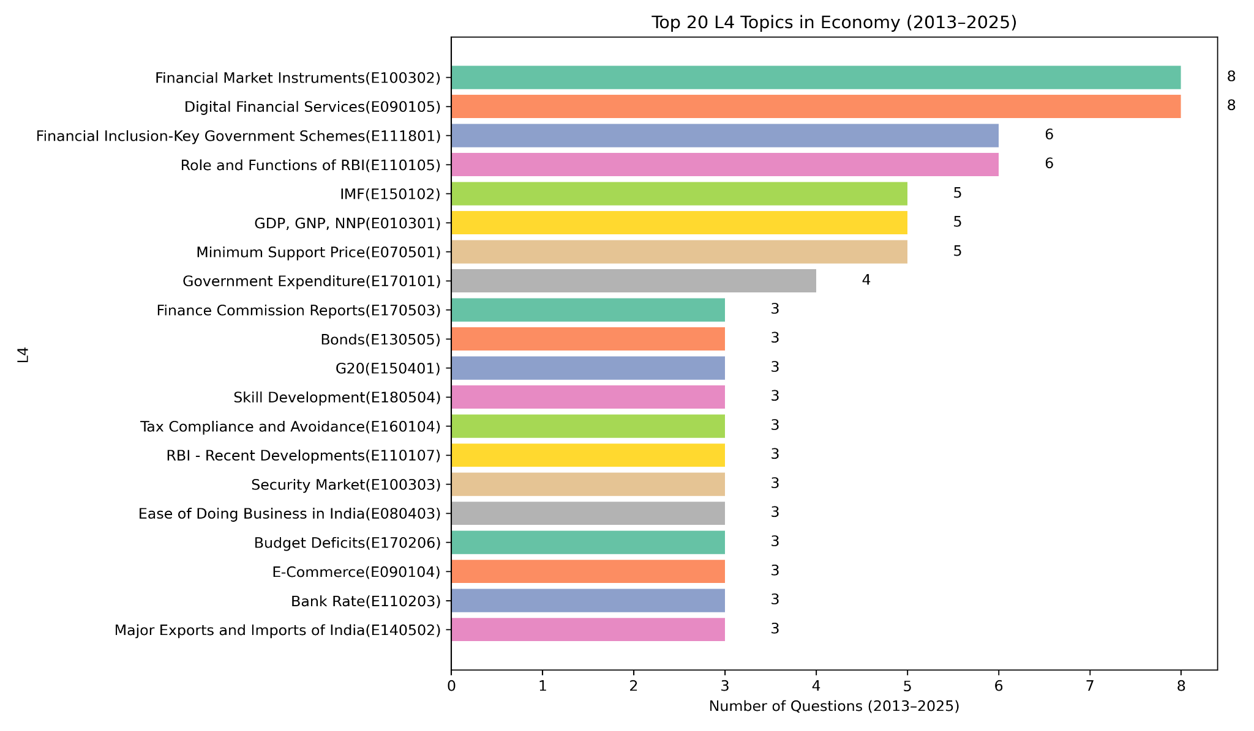

Slide 24
ENVIRONMENT

Slide 25
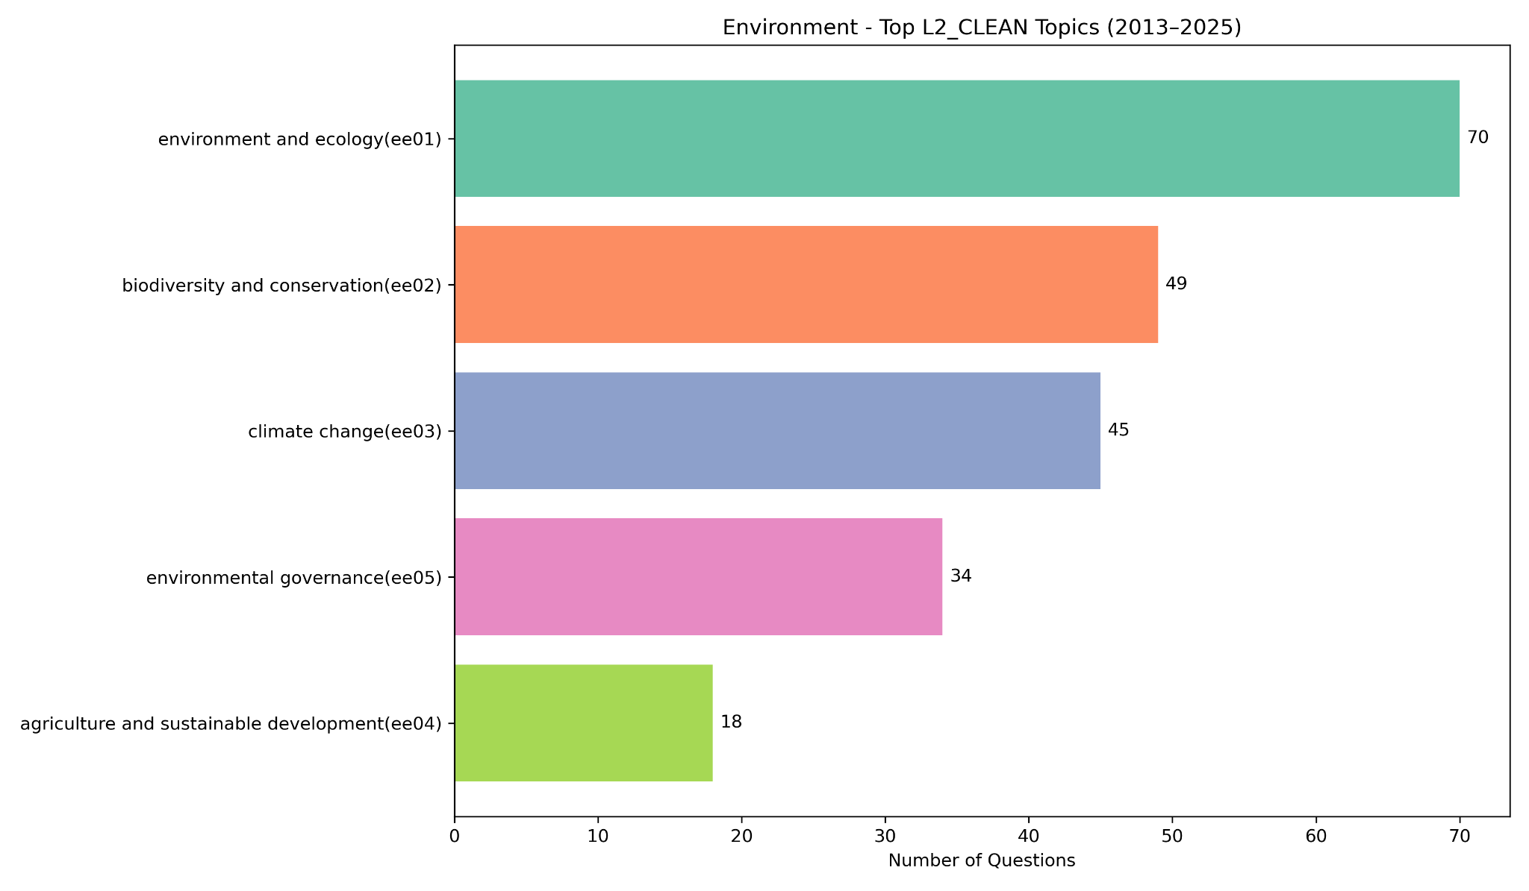

Slide 26
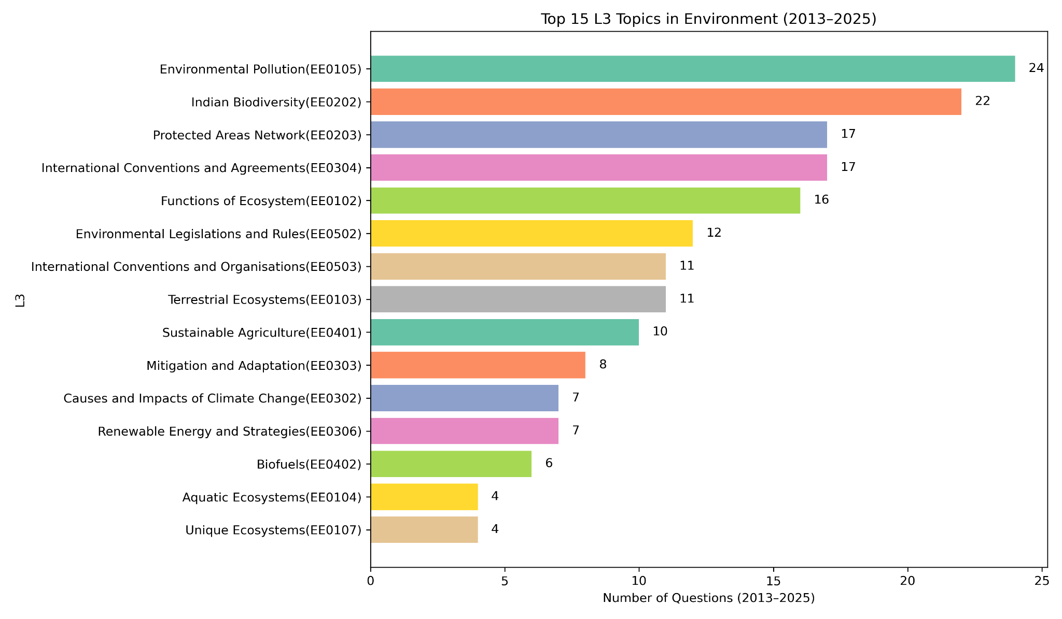

Slide 27
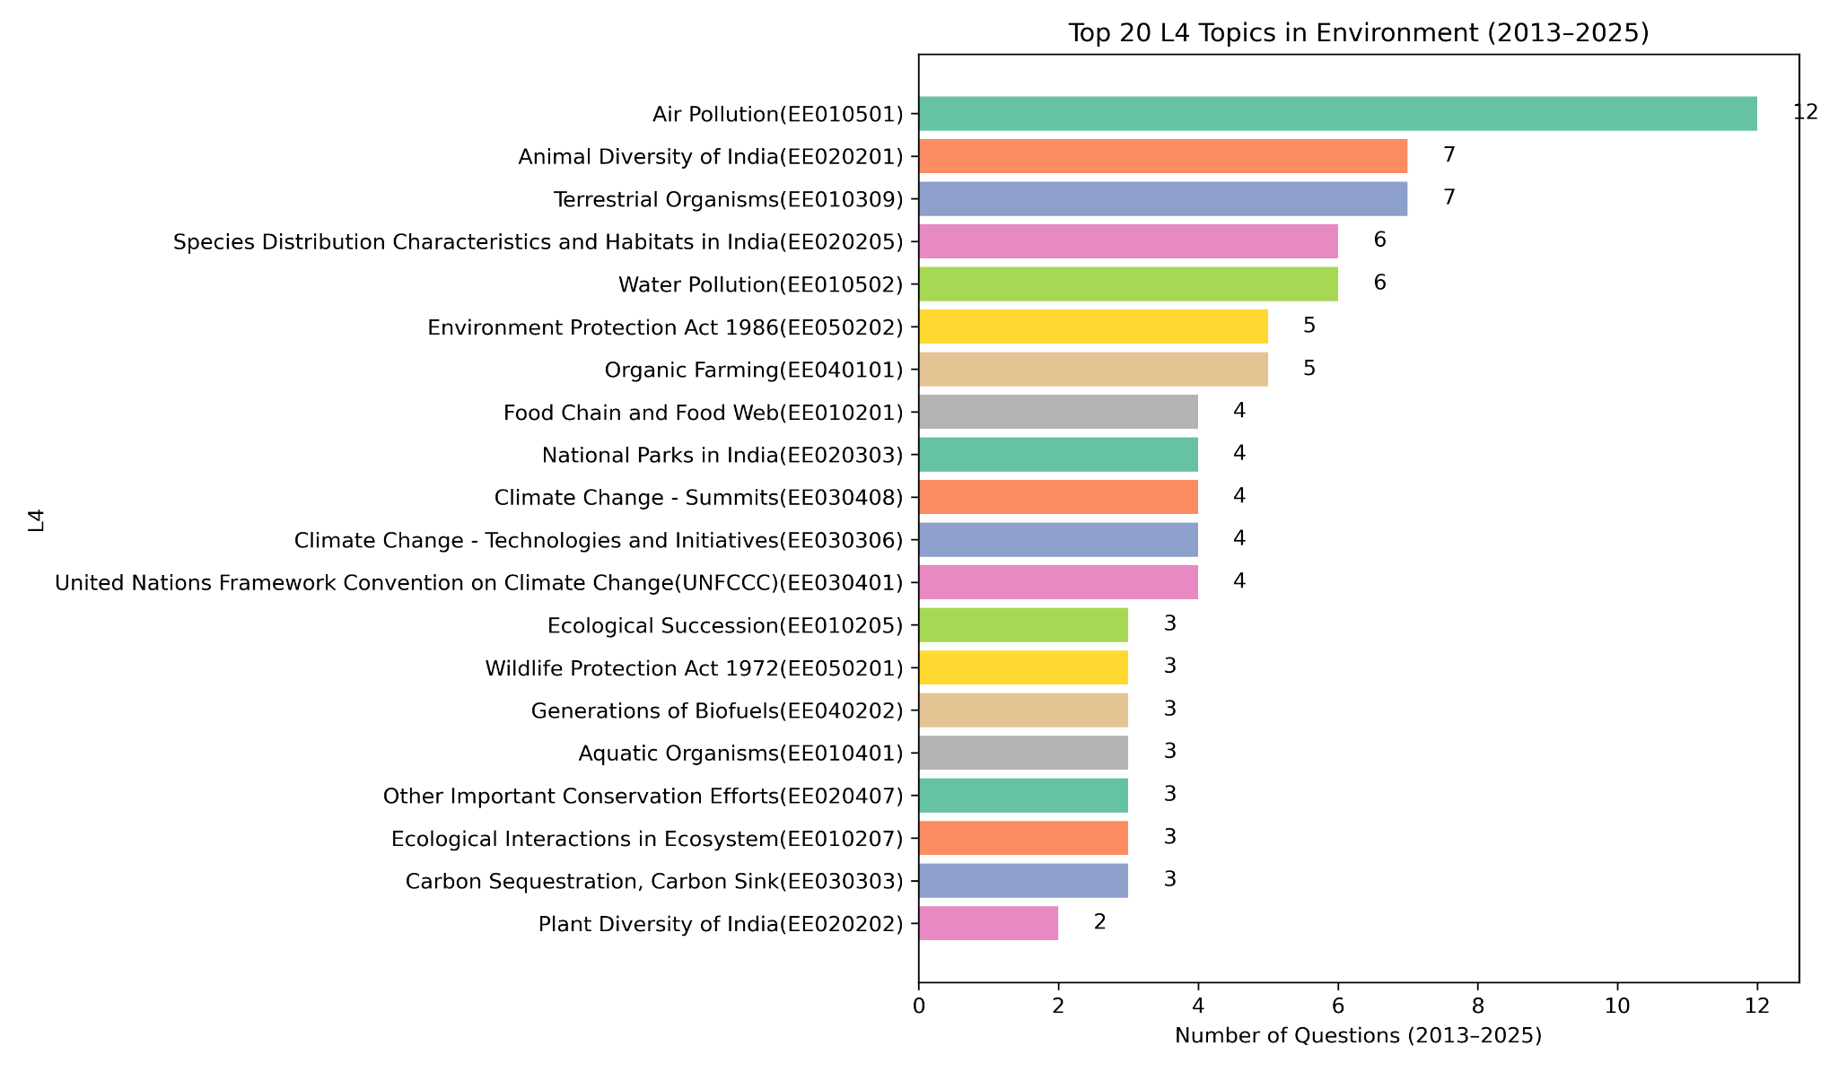

Slide 28
POLITY

Slide 29
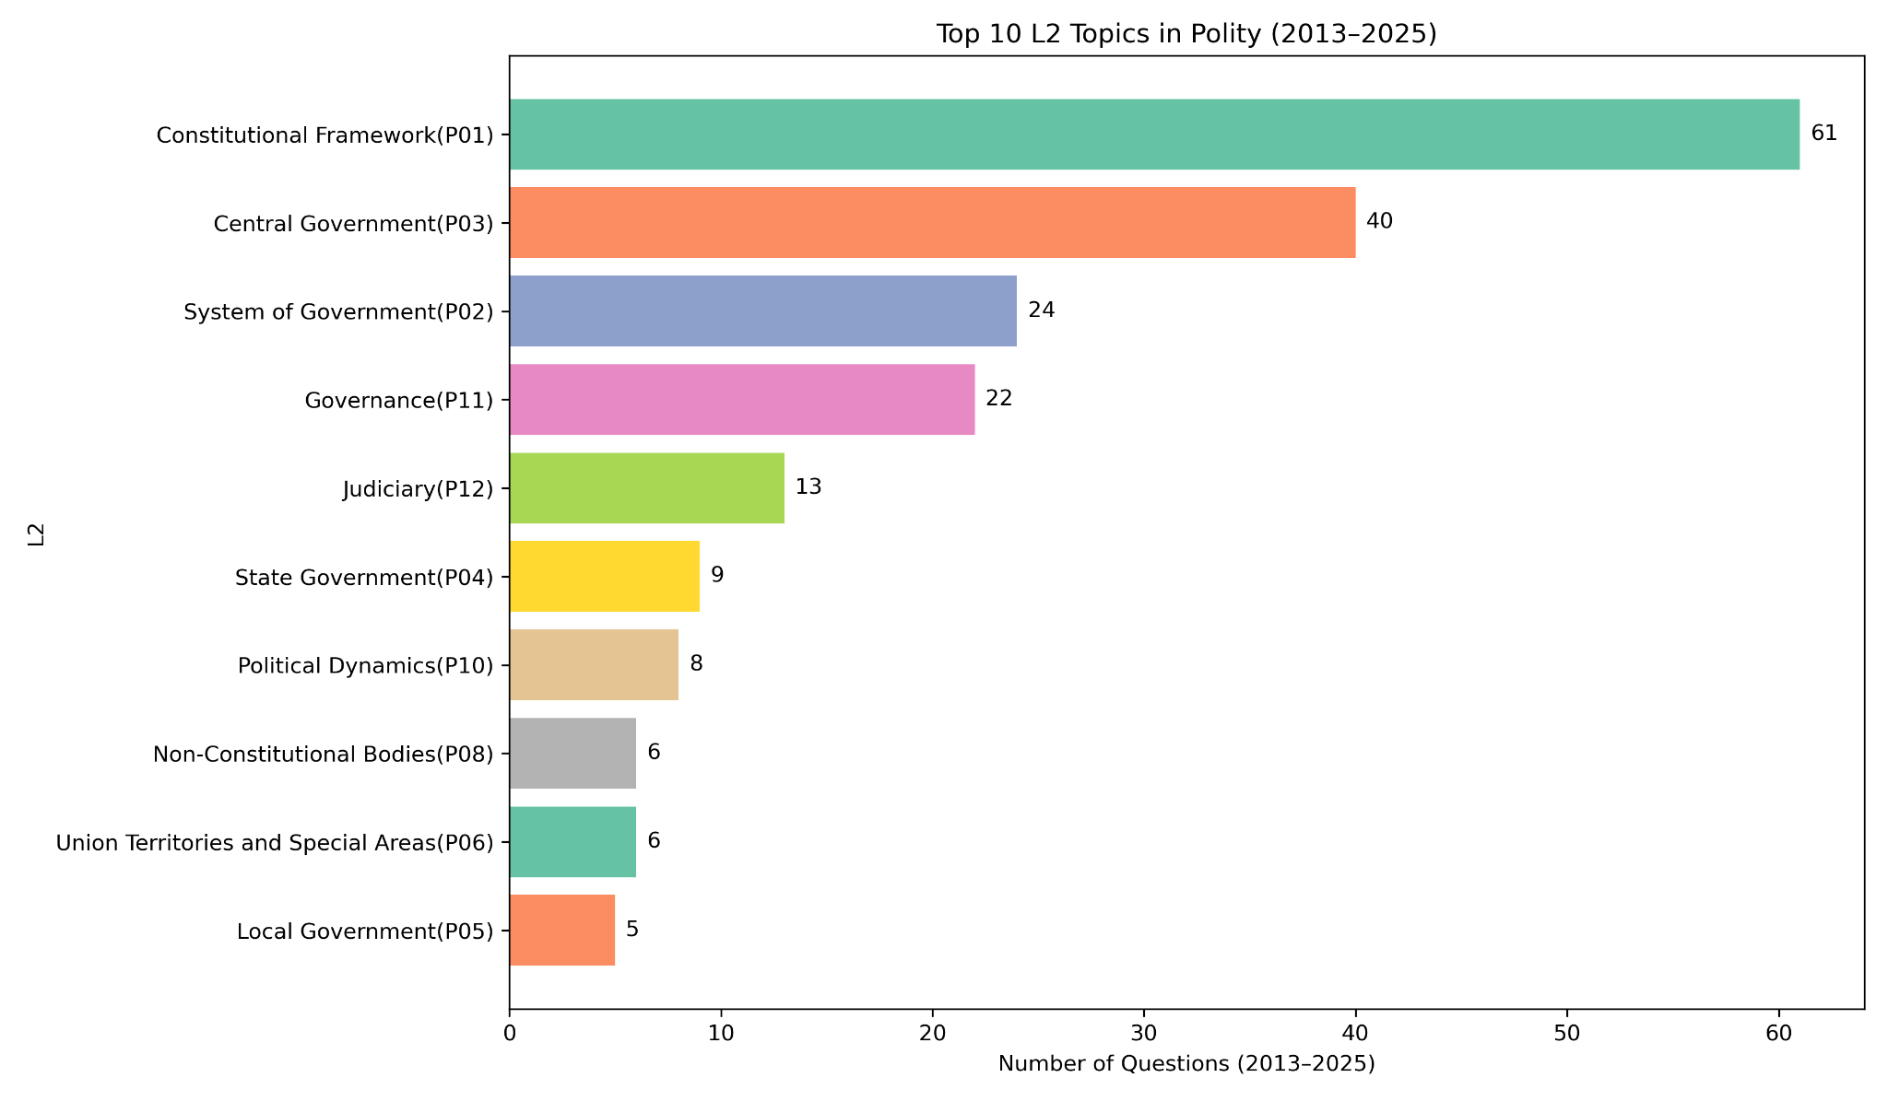

Slide 30
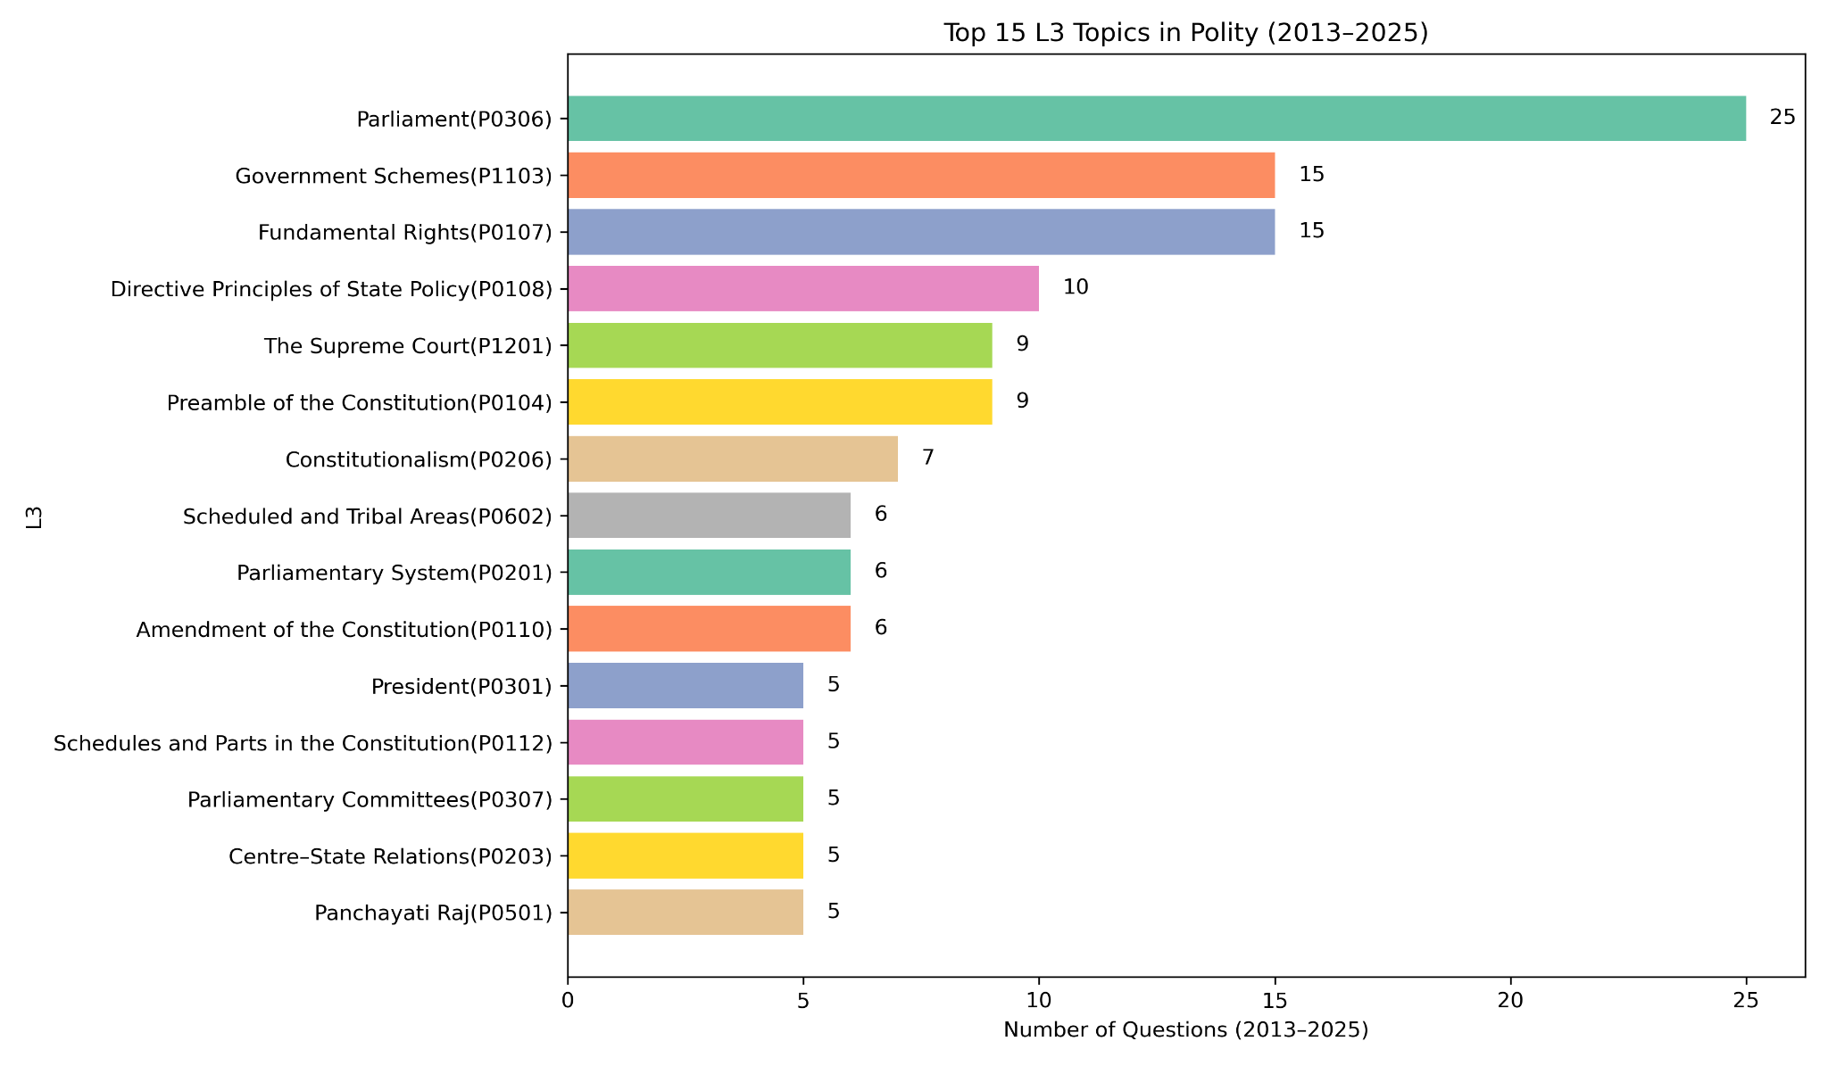

Slide 31
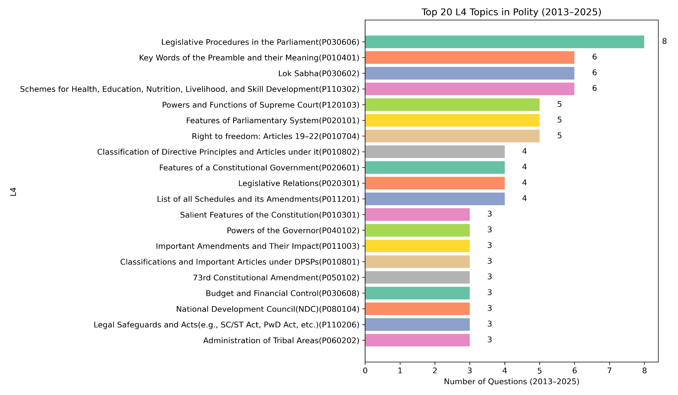

Slide 32
GEOGRAPHY

Slide 33
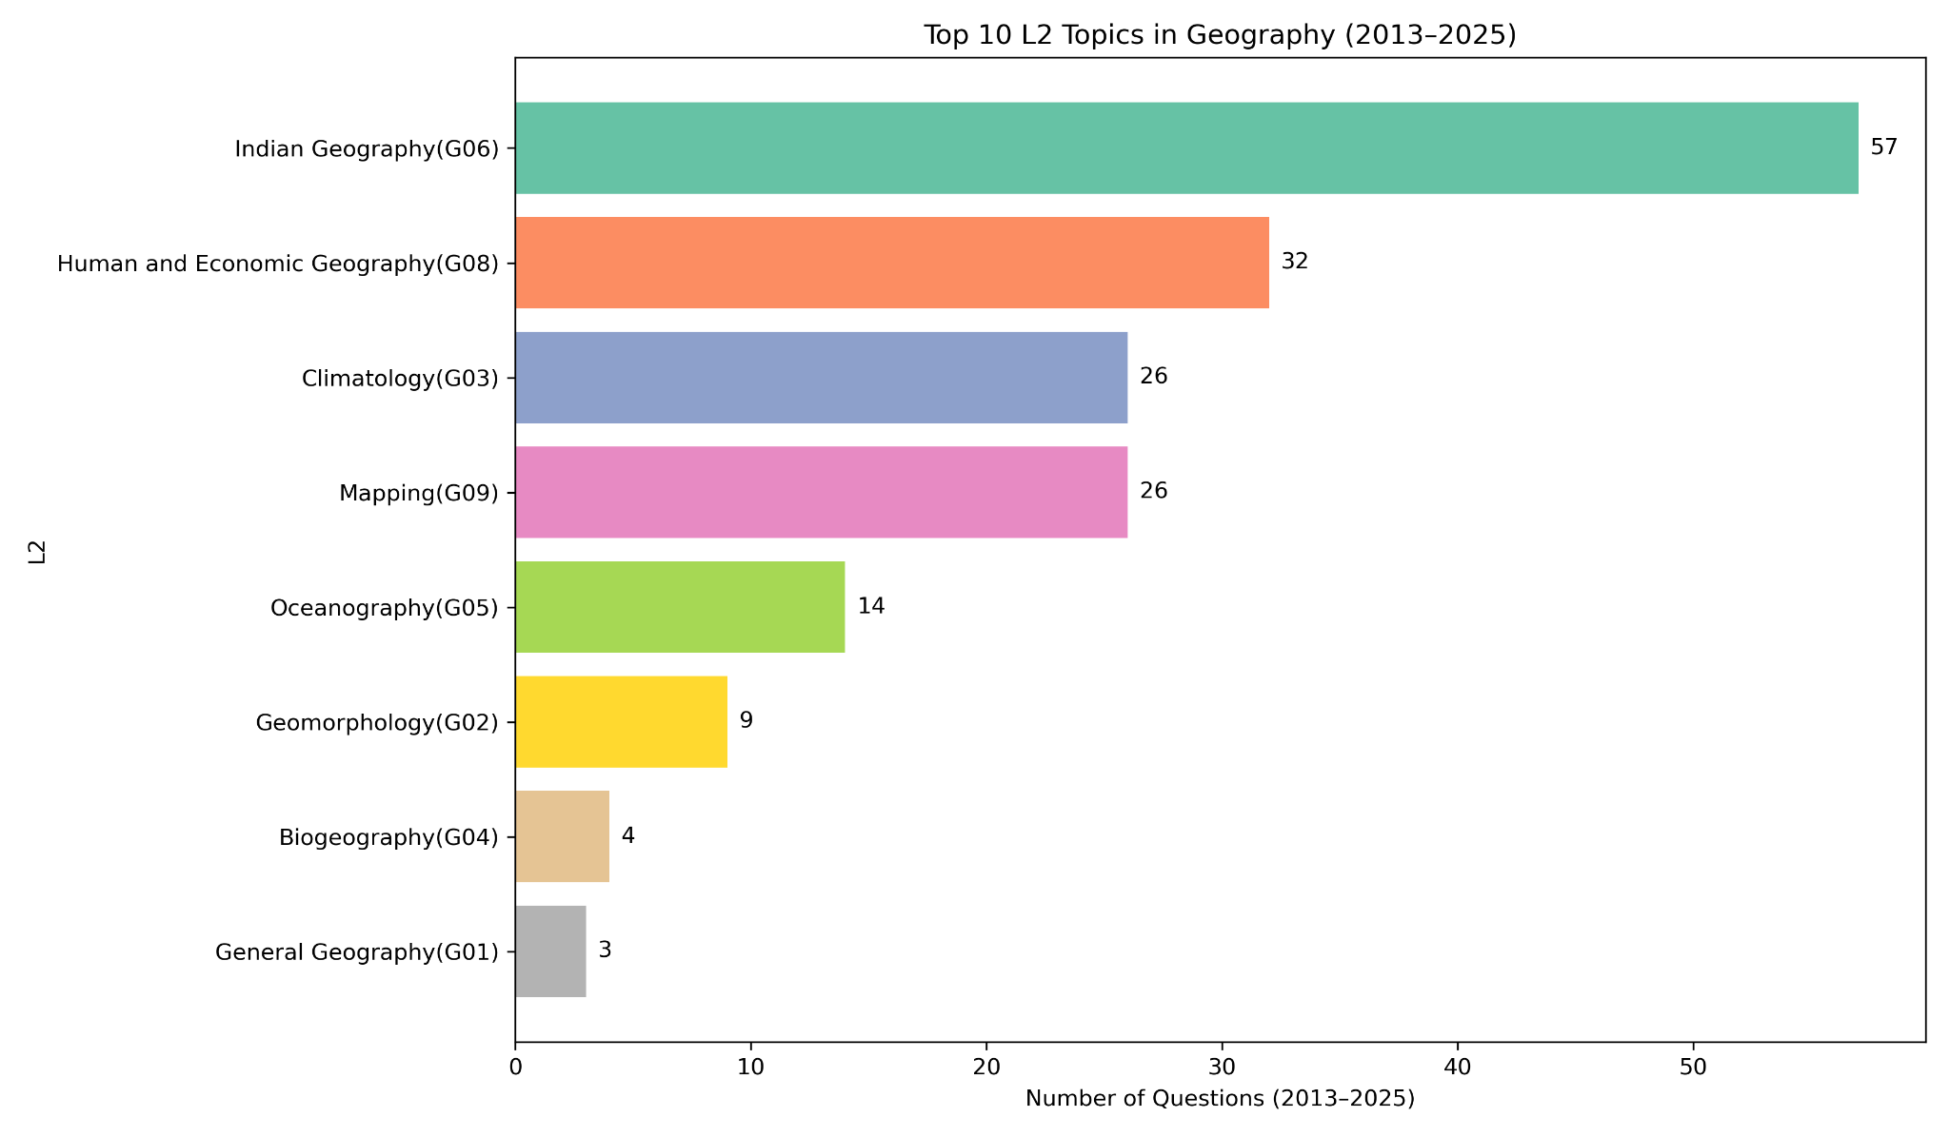

Slide 34
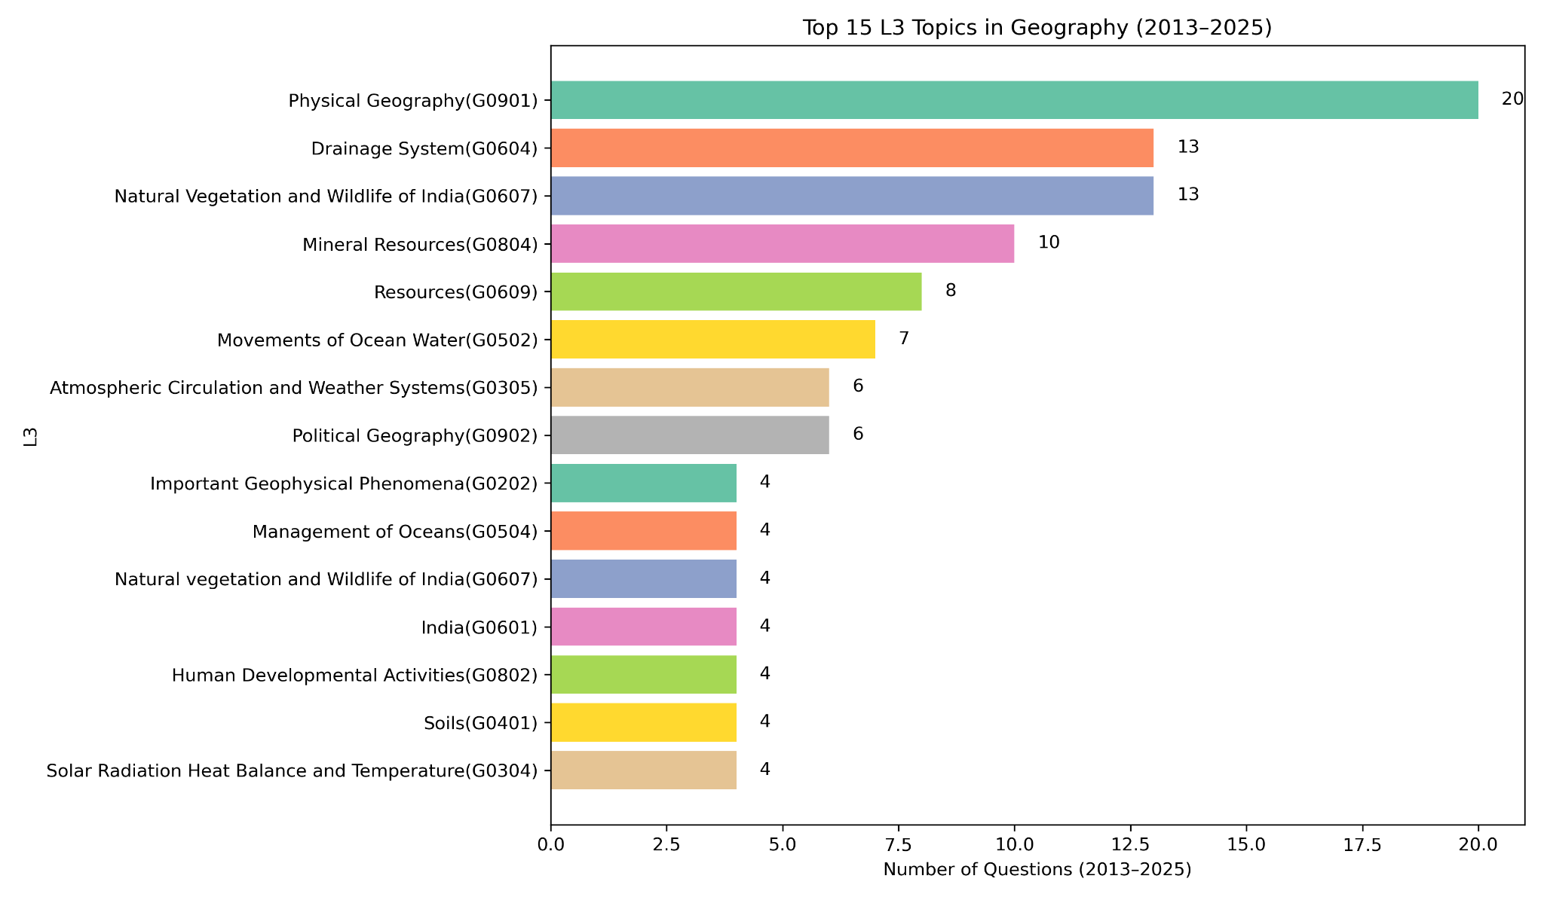

Slide 35
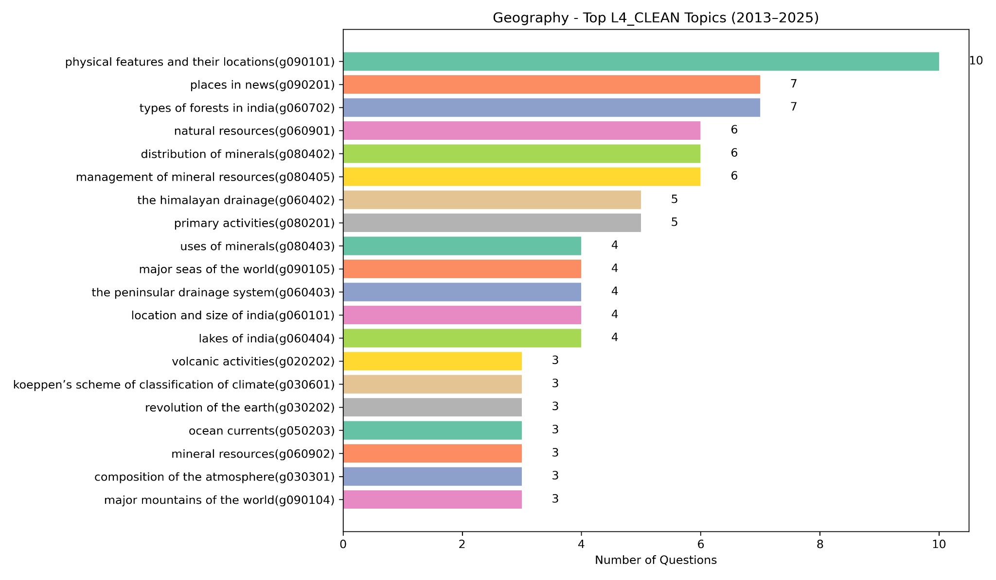

Slide 36
Science and Technology

Slide 37
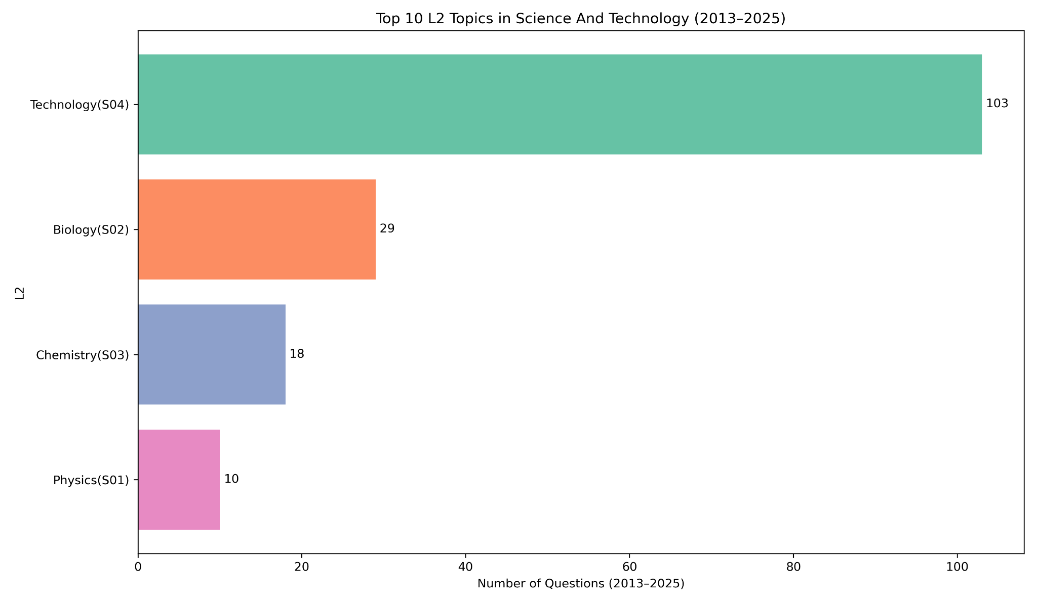

Slide 38
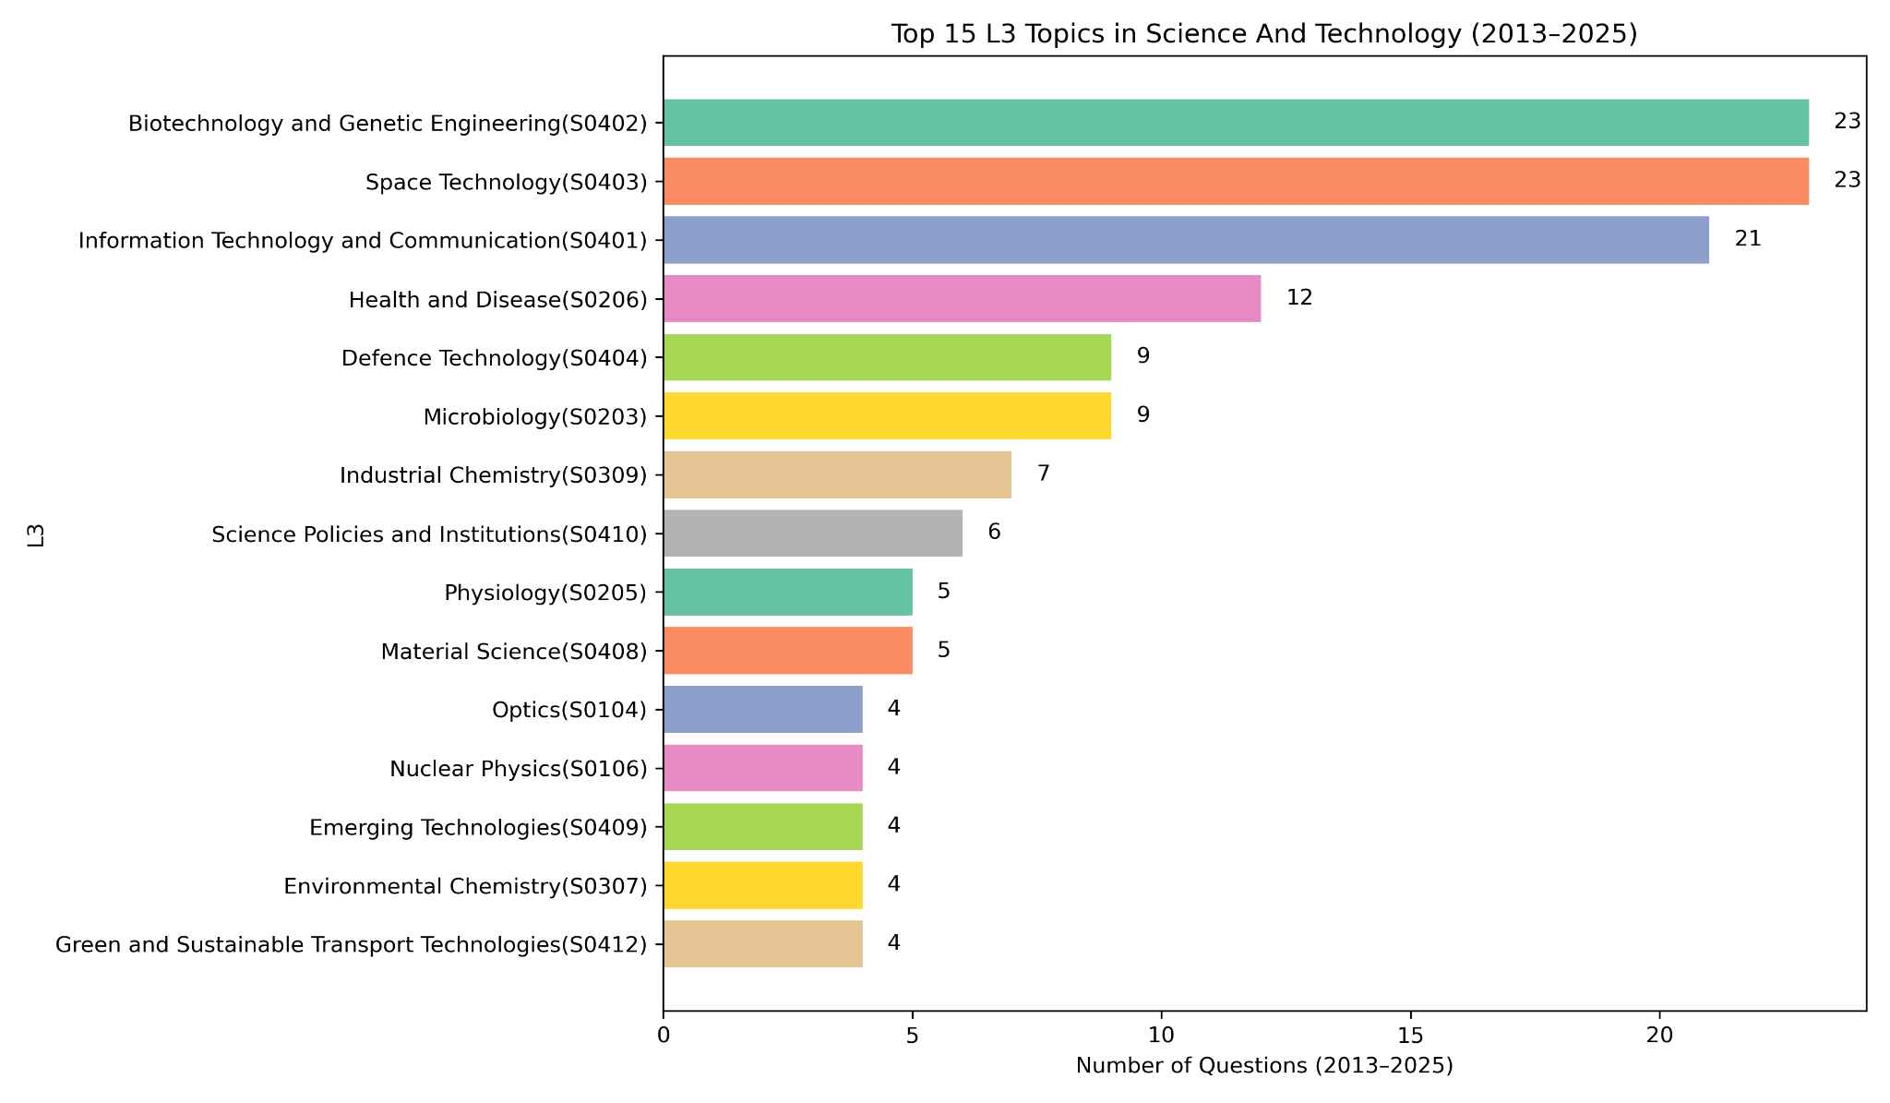

Slide 39
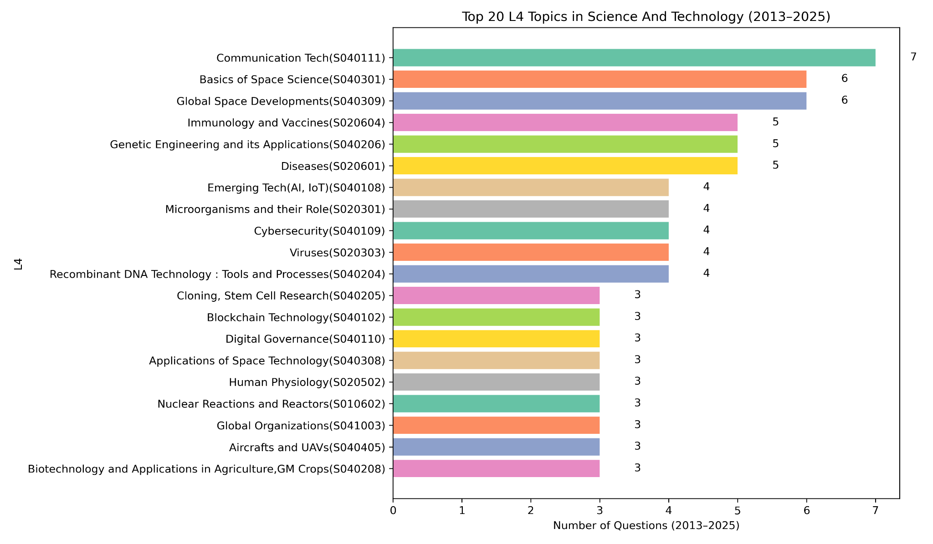

Slide 40
History

Slide 41
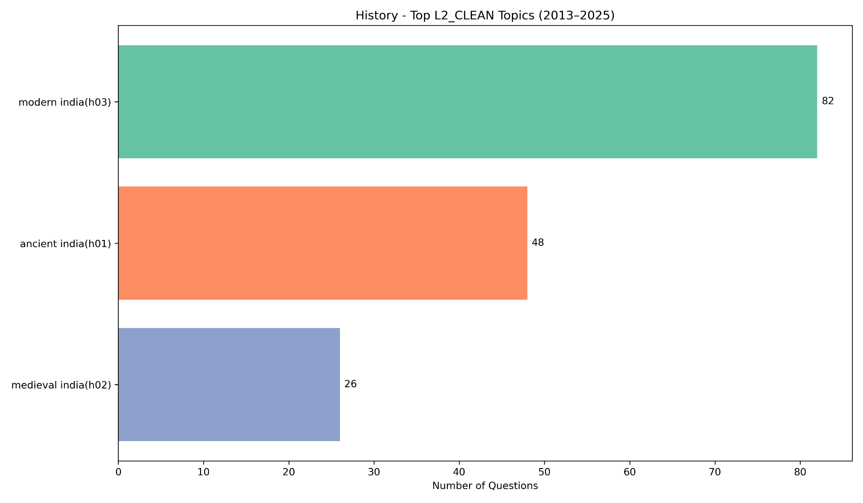

Slide 42
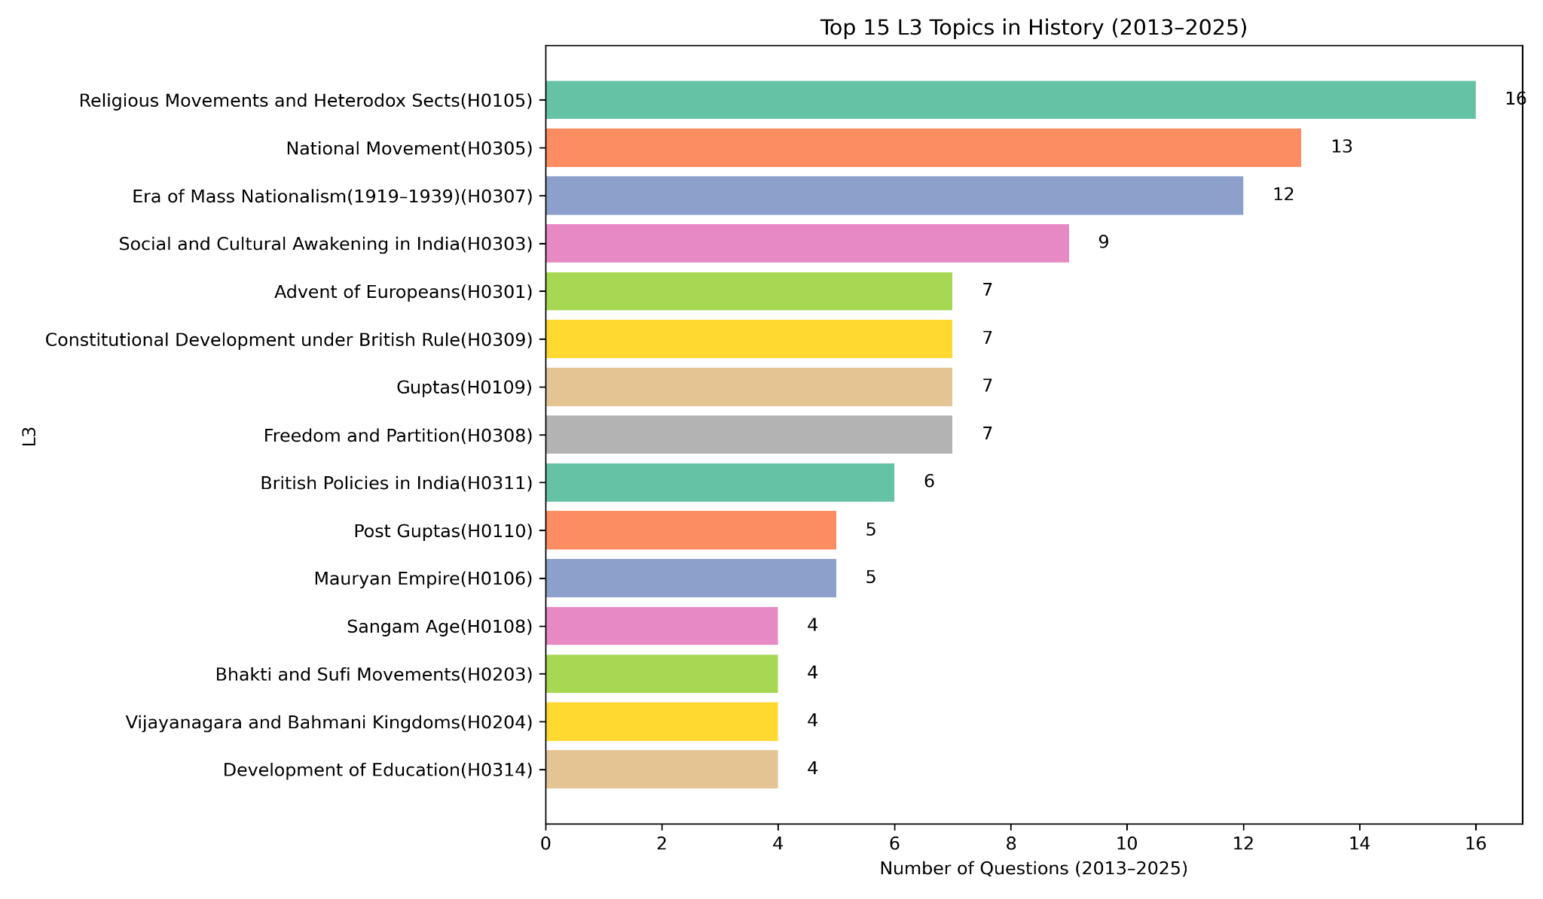

Slide 43
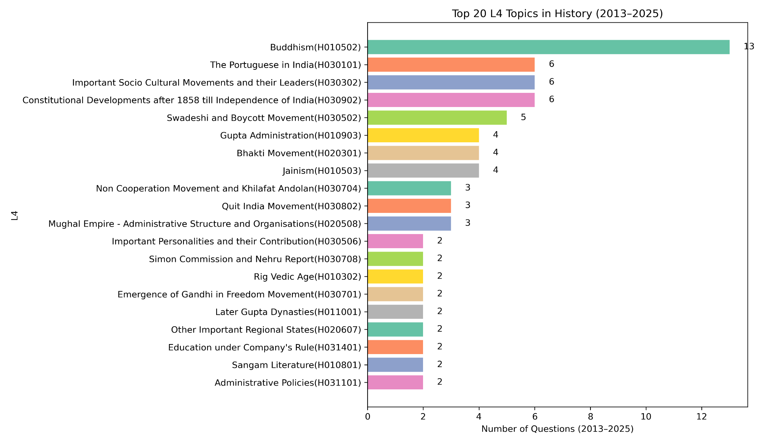

Slide 44
Art and Culture

Slide 45
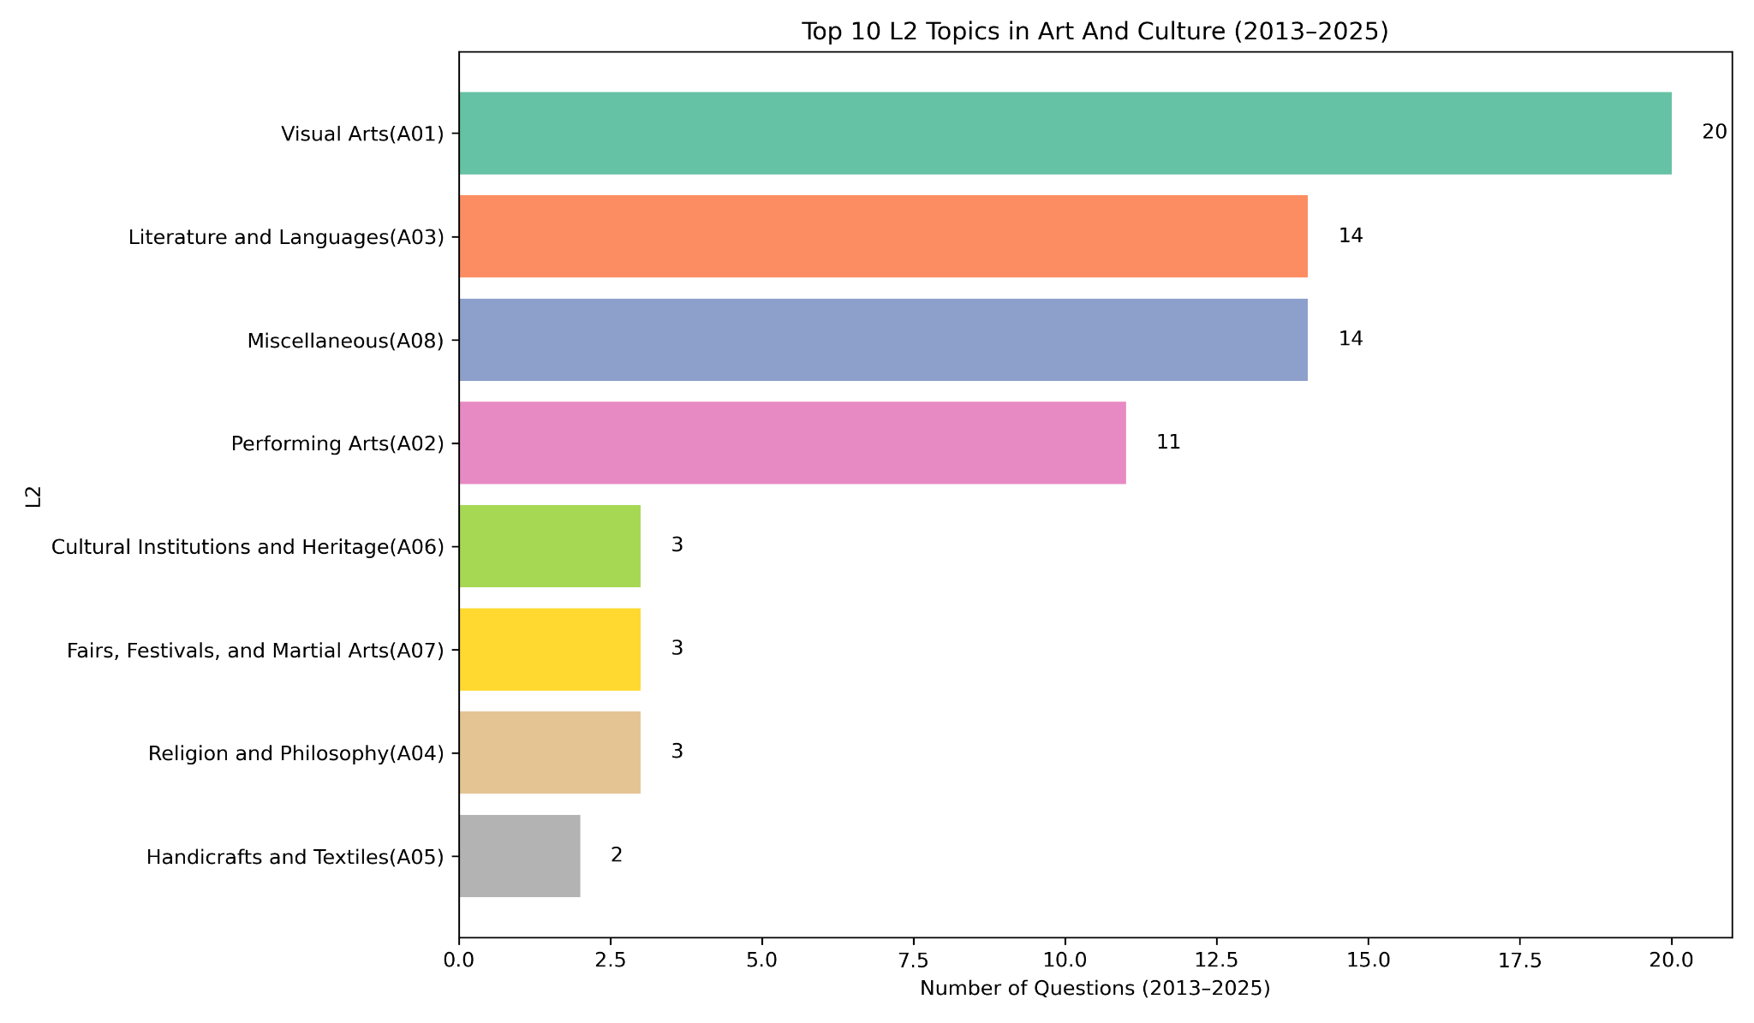

Slide 46
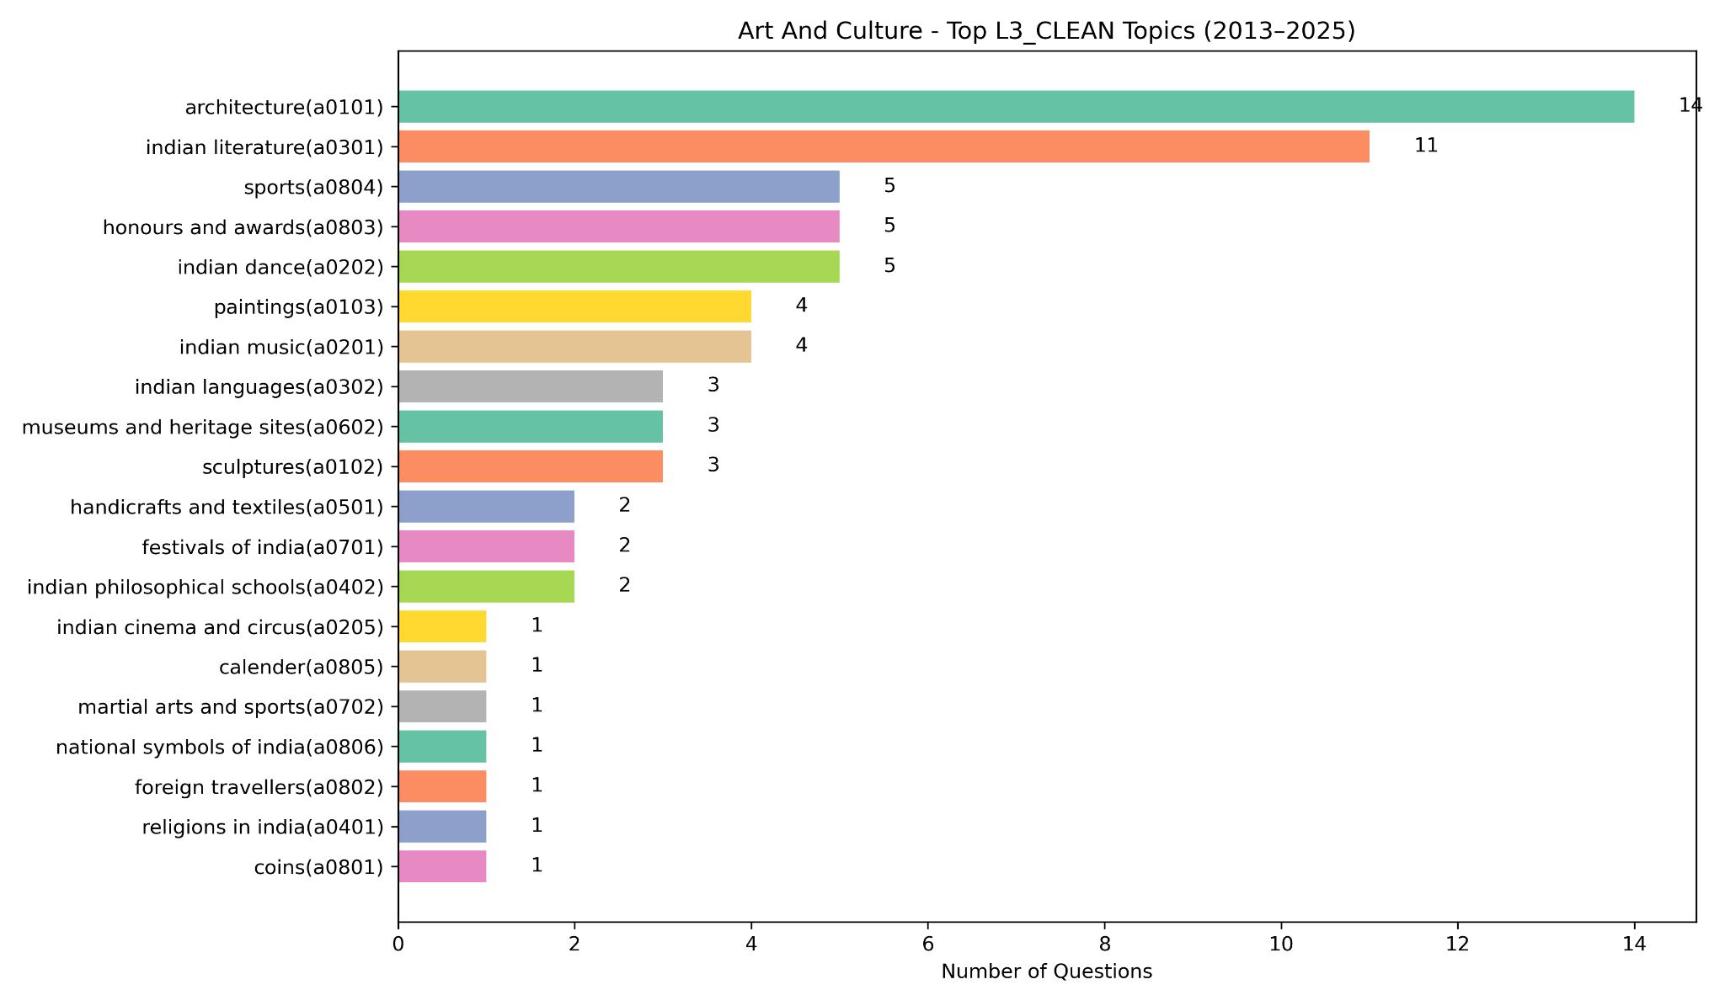

Slide 47
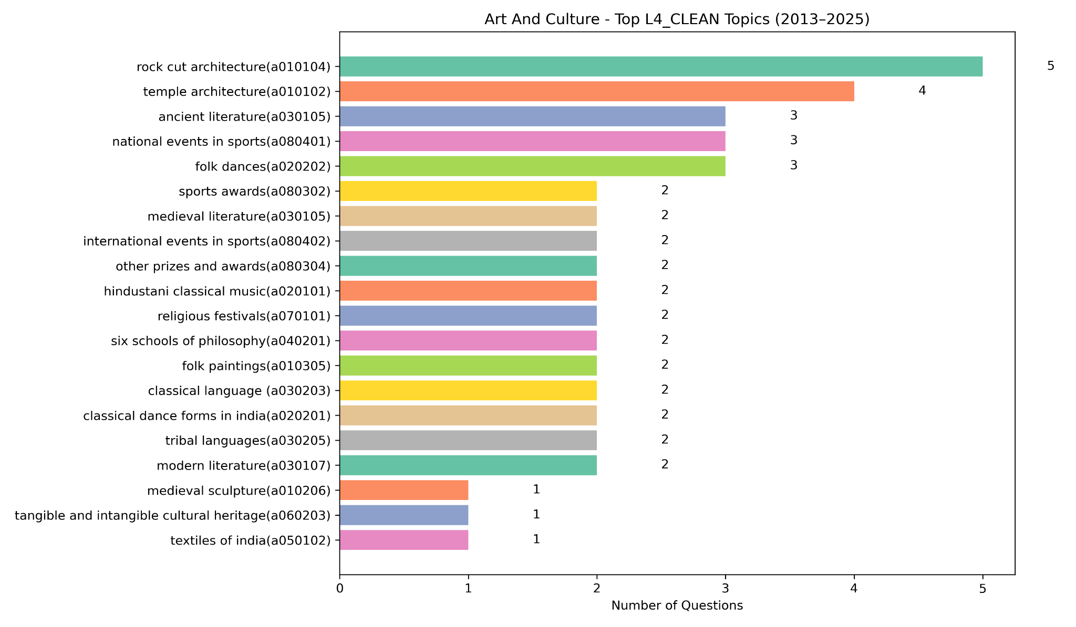

Slide 48
International Relations and Internal Security

Slide 49
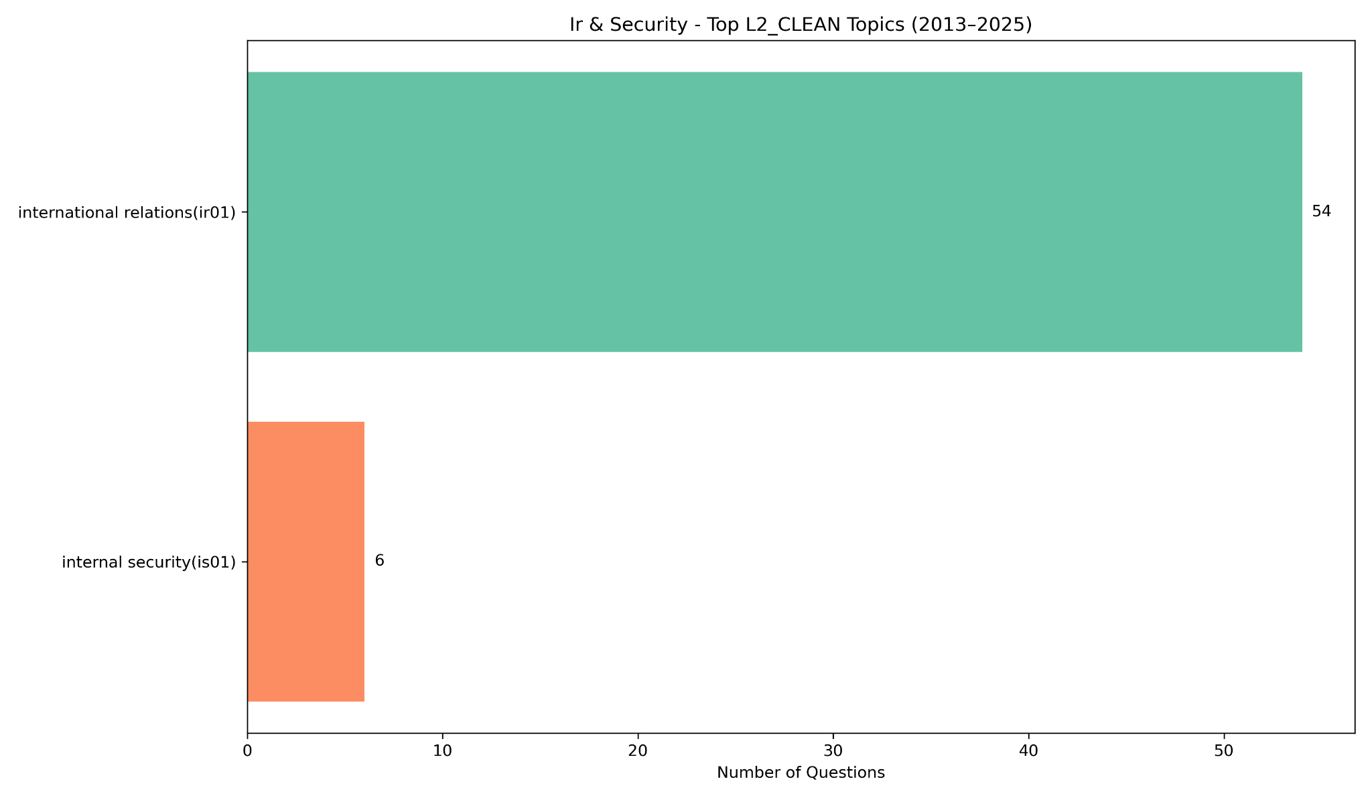

Slide 50
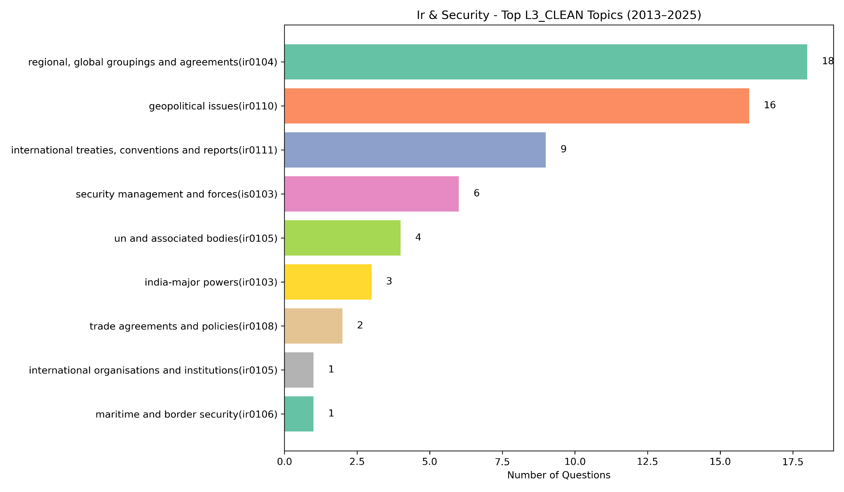

Slide 51
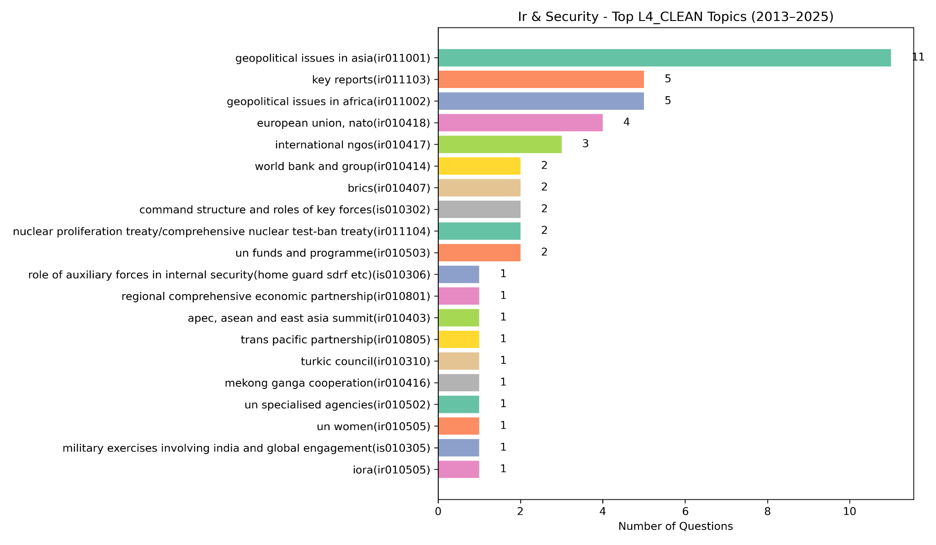

Slide 52
Subject-Wise Total Counts from 2013 to 2025

Slide 53
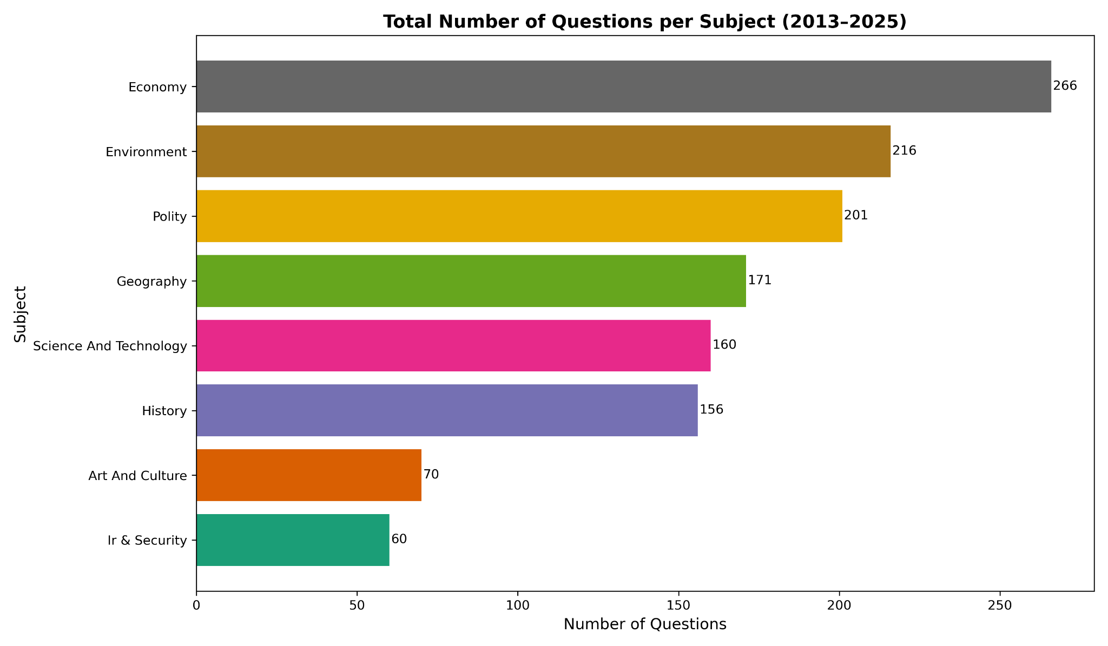

Slide 54
Polity, Economy, Environment together make up 50–60% of all PYQs.
History and Geography follow next with 15–20% share combined.
Art & Culture, Science & Tech, IR & Security share the remaining 20%.

